Slide 1
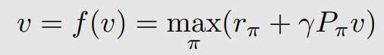
时序差分与经典的RL算法
最优Belman方程
最优Belman方程
求解v：迭代更新
方法：学习随机变量的期望值
采样数据，平均值估计
预测 —(拿到新的数据/增量)---->更新预测
算法：
TD Learning of state value
Sarsa算法：TD learning of action values
Q-Learning算法：TD learning of optimal action values
概念熟悉下：
On policy & off policy
Behavior policy： 生成经验数据
target policy ： 目标策略- 最优策略
假设：环境模型未知
利用数据！
model-free RL Algorithm

Slide 2
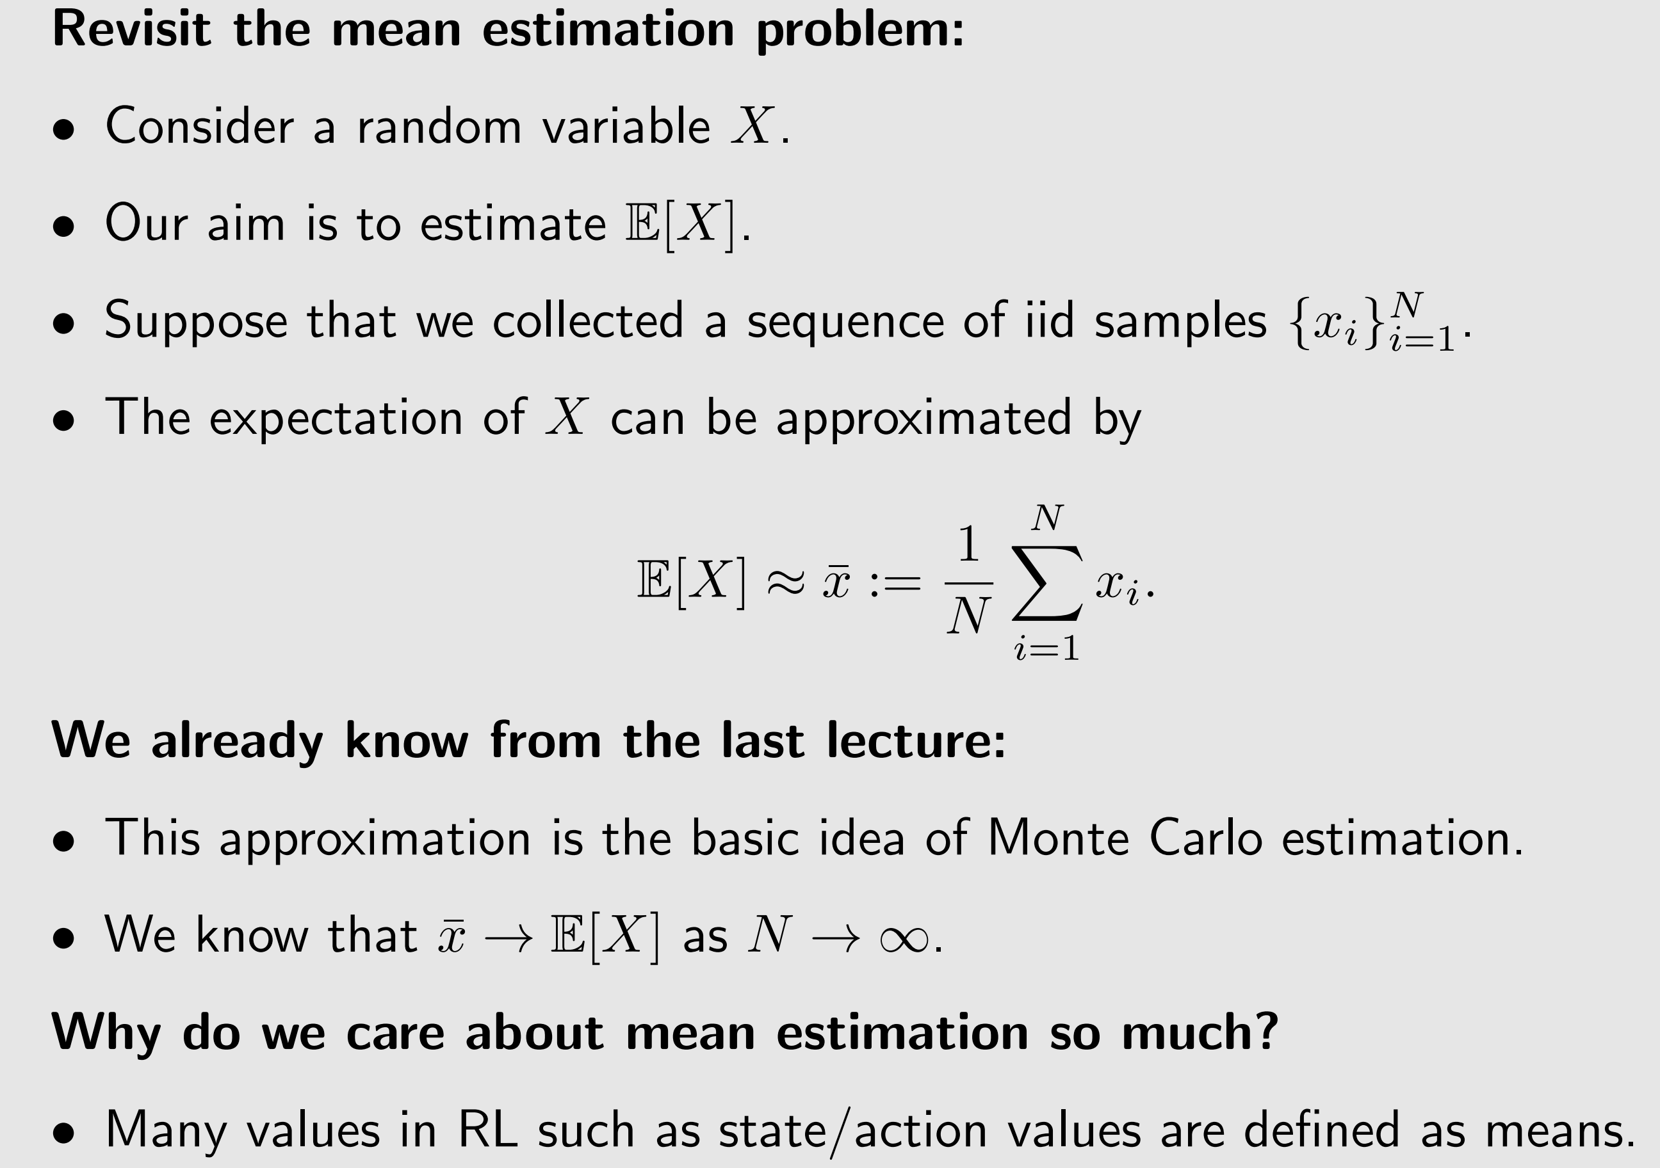
Motivating example: mean estimation, again

Slide 3
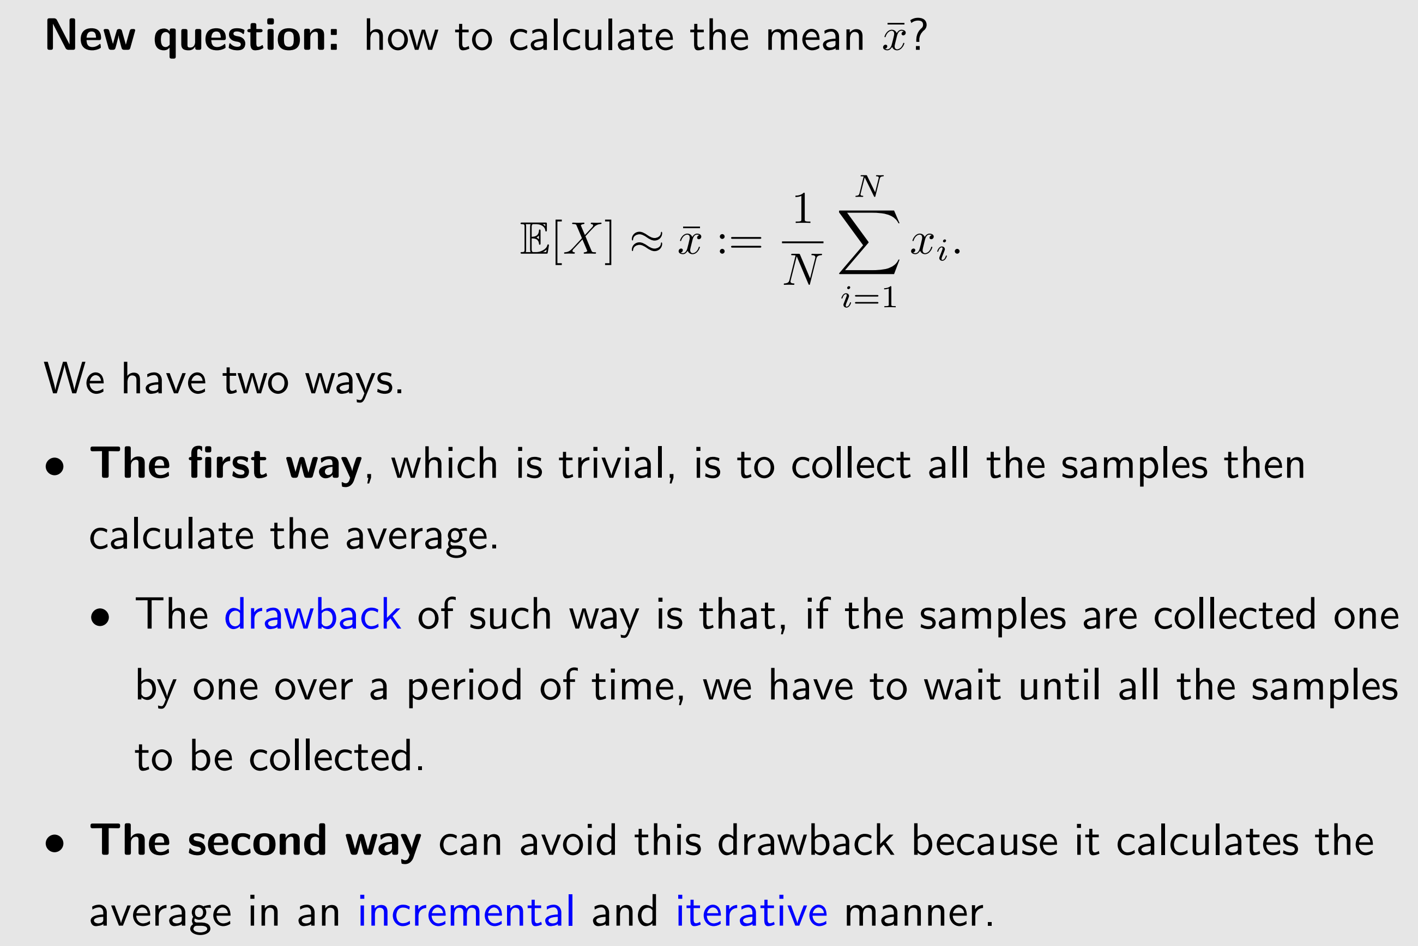
Motivating example: mean estimation, again

Slide 4
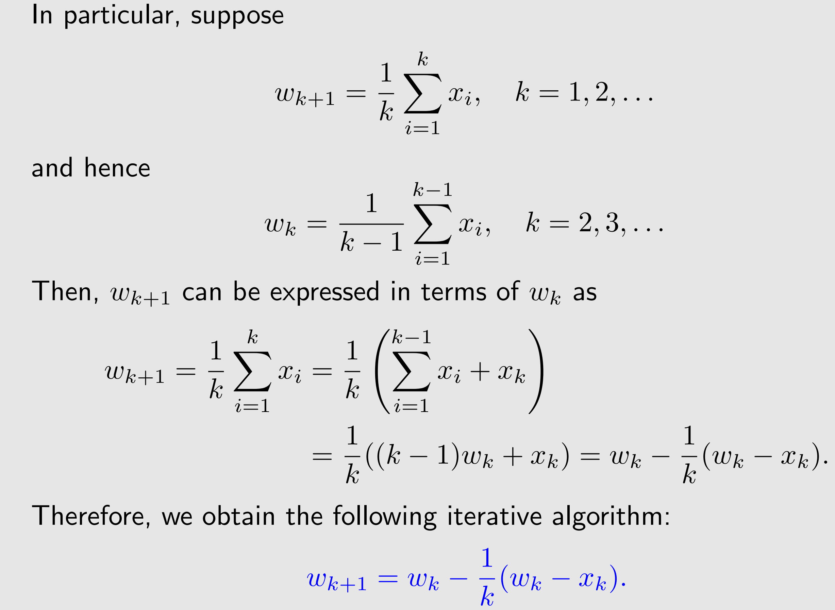
Motivating example: mean estimation, again

Slide 5
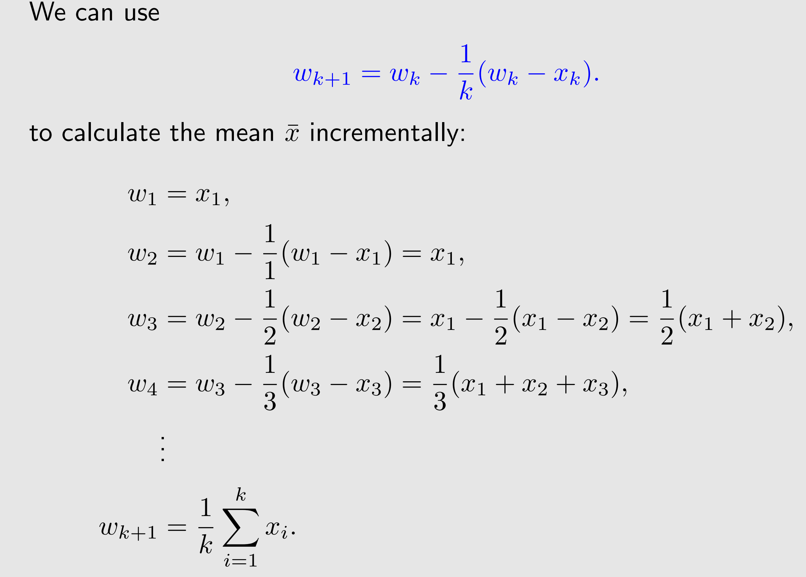
Motivating example: mean estimation, again

Slide 6
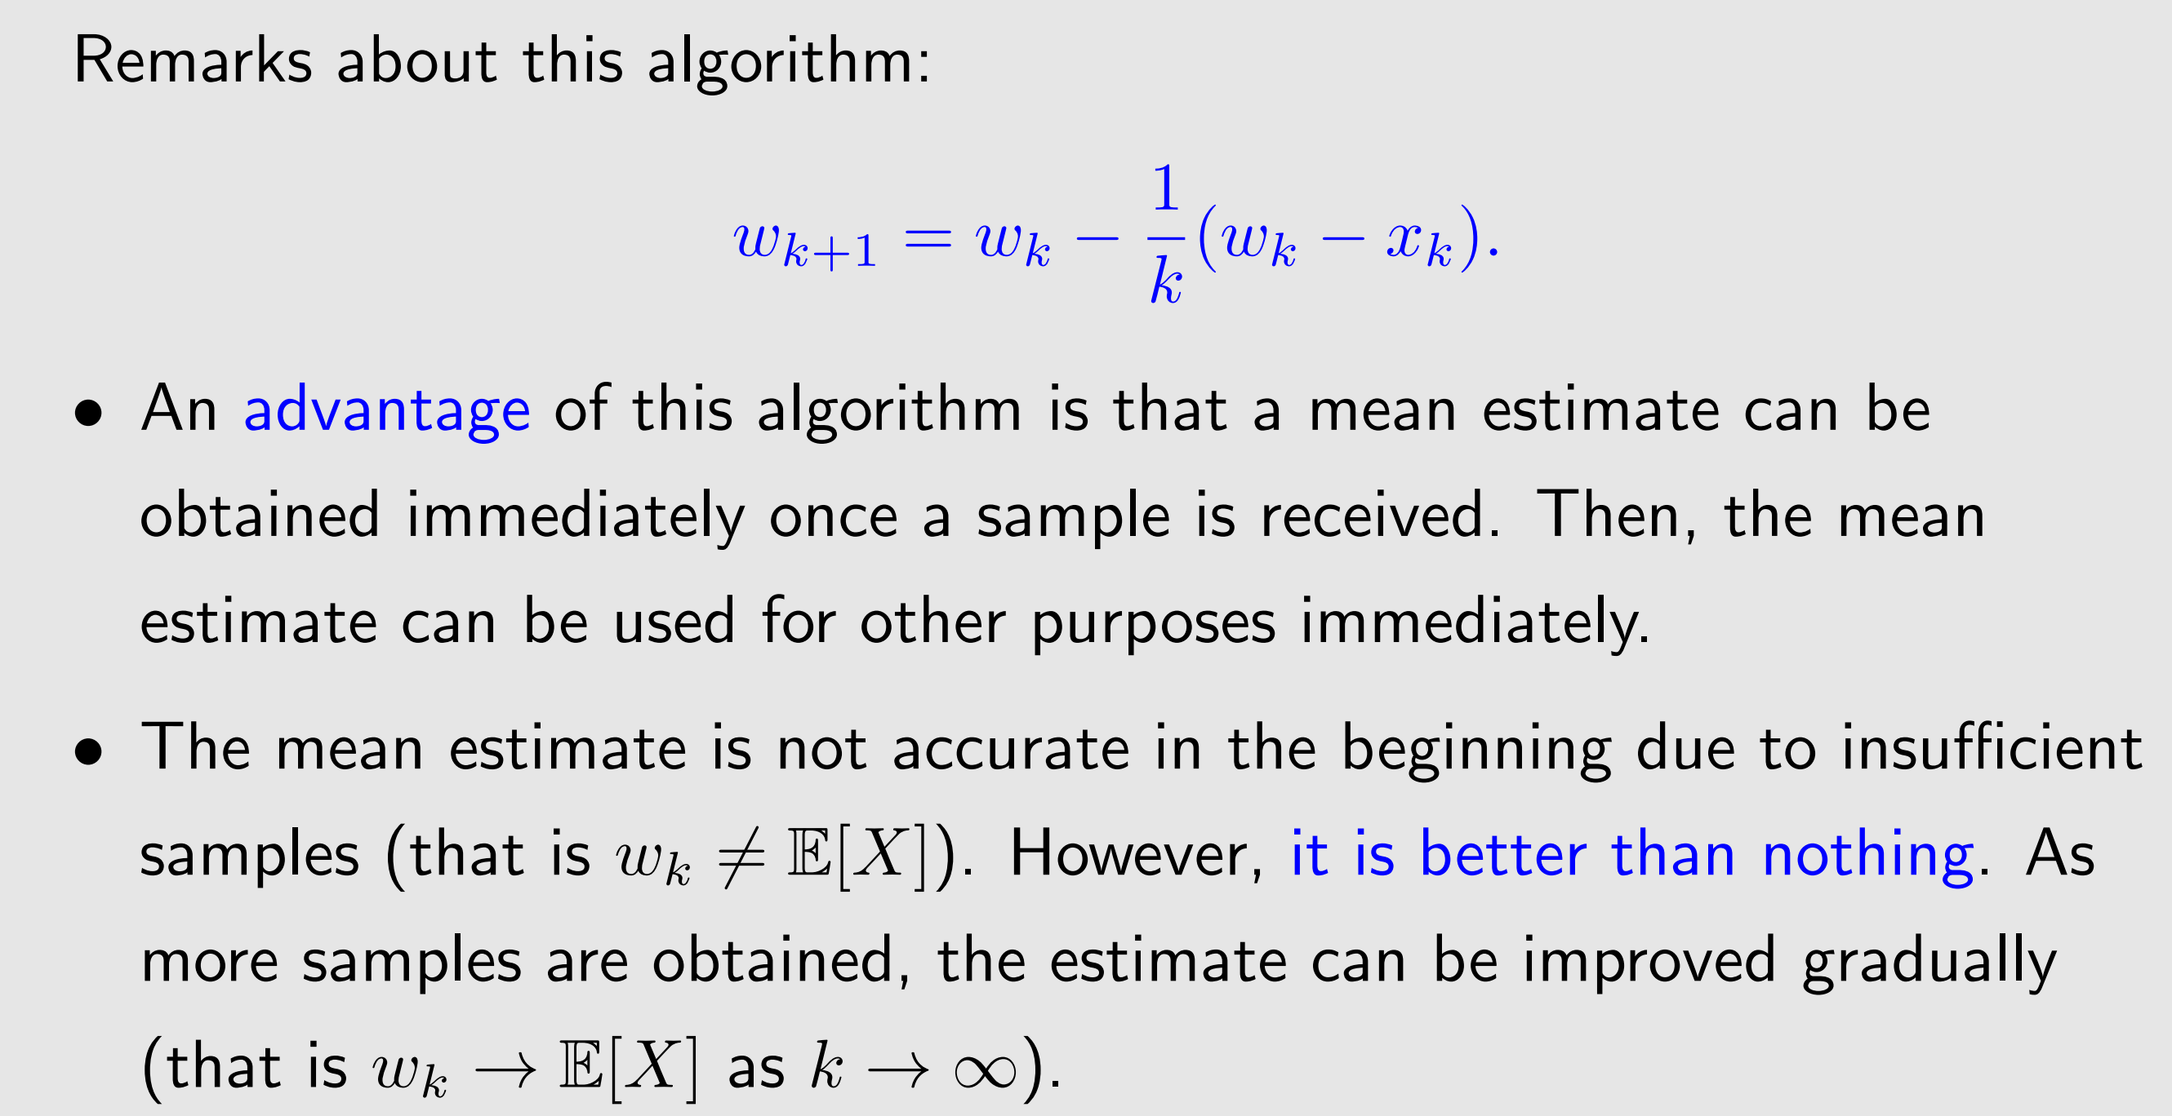
Motivating example: mean estimation, again

Slide 7
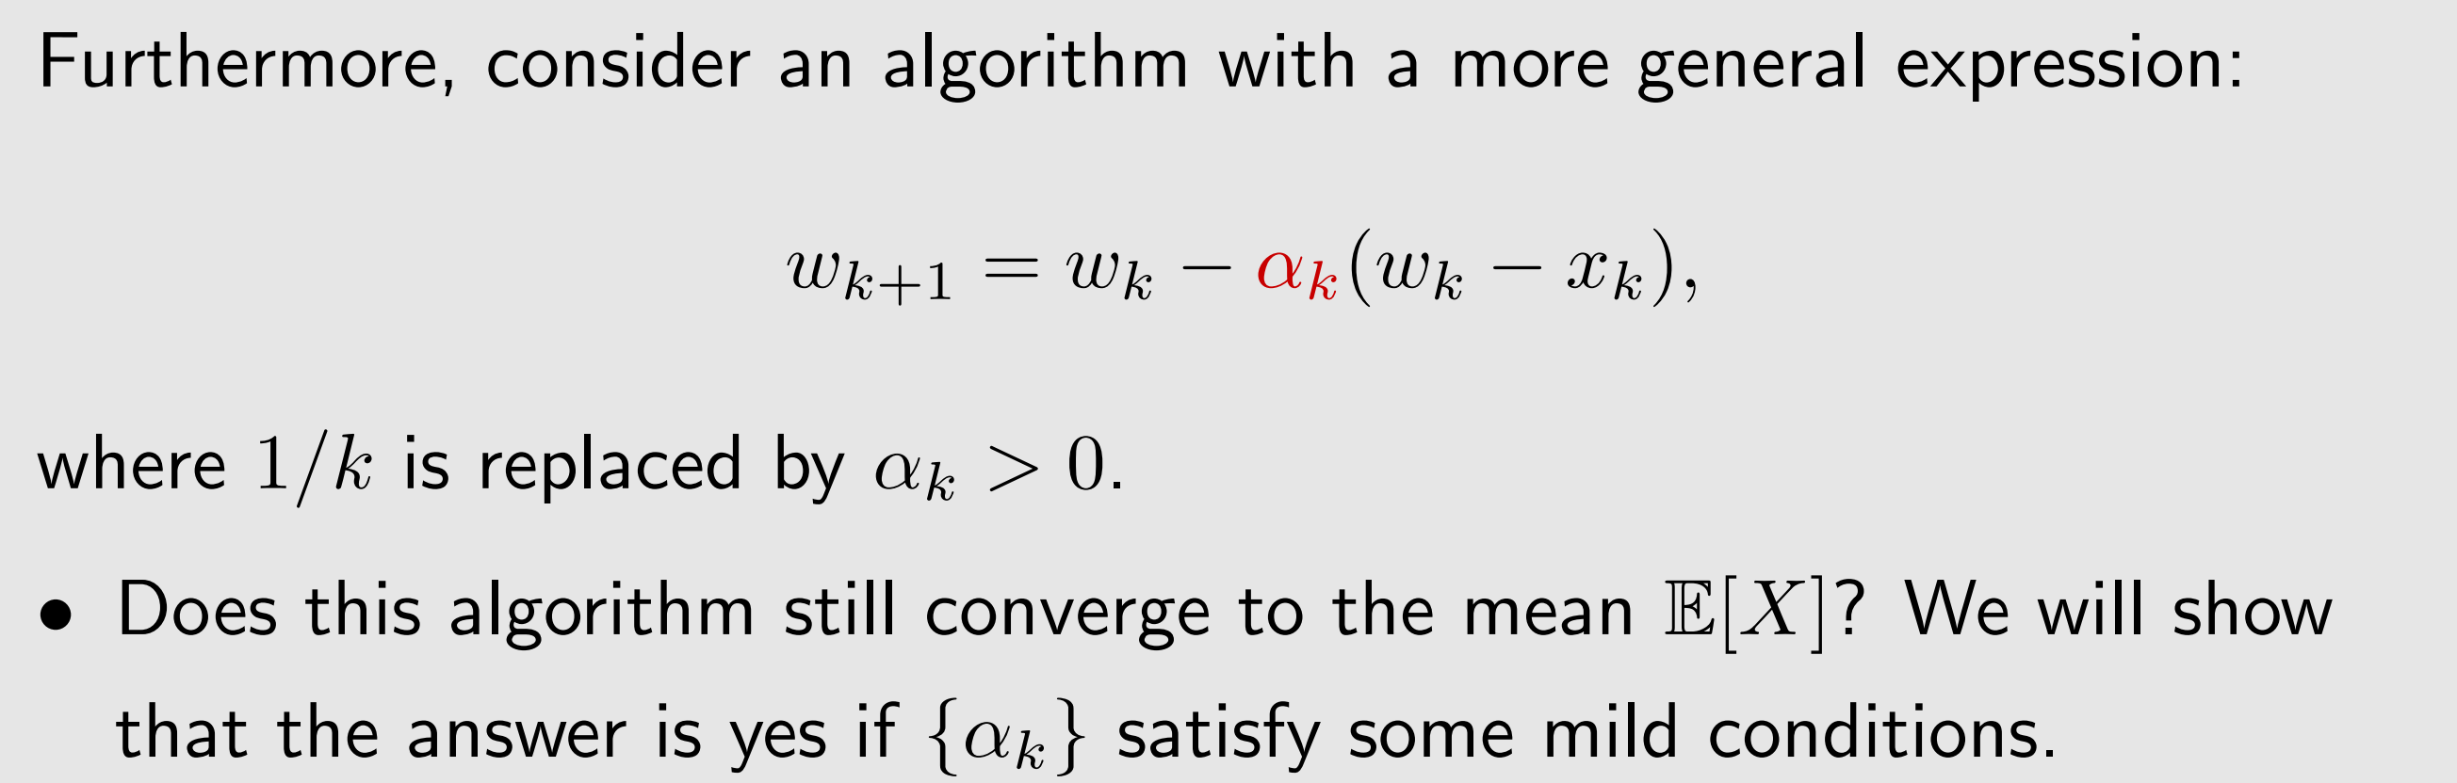
Motivating example: mean estimation, again

Slide 8
基于时序差分的RL
Temporal-difference (TD) learning, which is one of the most well-known methods in reinforcement learning (RL).
Review: Monte Carlo (MC) learning – the first model-free method.
基于episode 评估策略，提高策略 一条轨迹
Non - incremental的方法
TD learning - the second model-free method. TD has some advantages compared to MC. - Incremental方法

Slide 9
基于时序差分的RL
1 Motivating examples
2 TD learning Algorithm
TD learning of state values
TD learning of action values: Sarsa
TD learning of action values: Expected Sarsa
TD learning of action values: n-step Sarsa
TD learning of optimal action values: Q-learning
7 A unified point of view
8 Summary

Slide 10
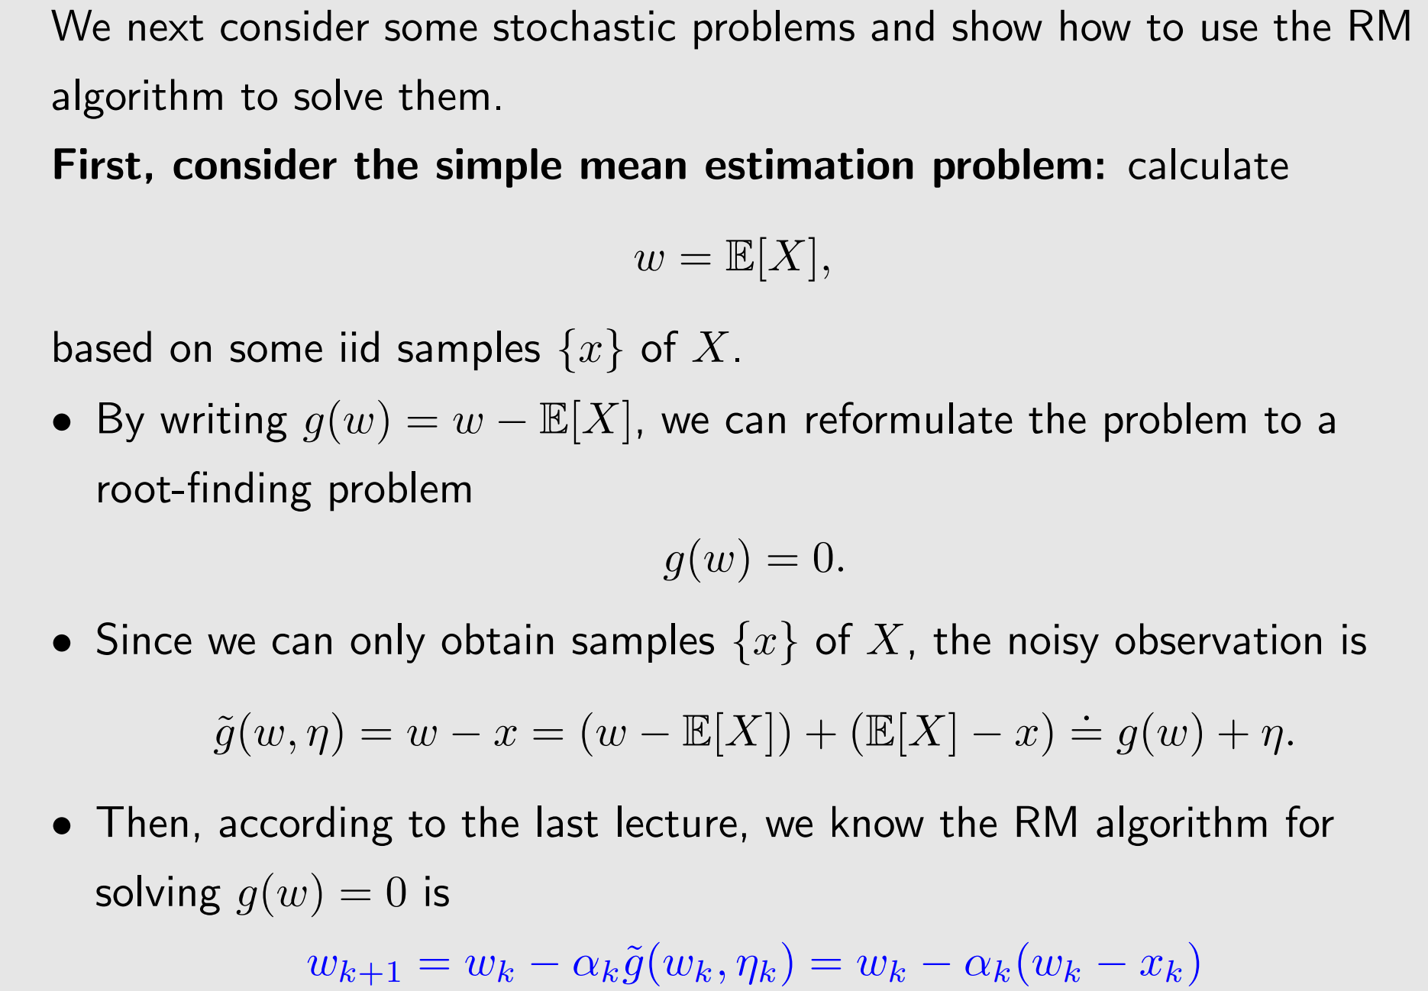
Simple example: stochastic algorithms

Slide 11
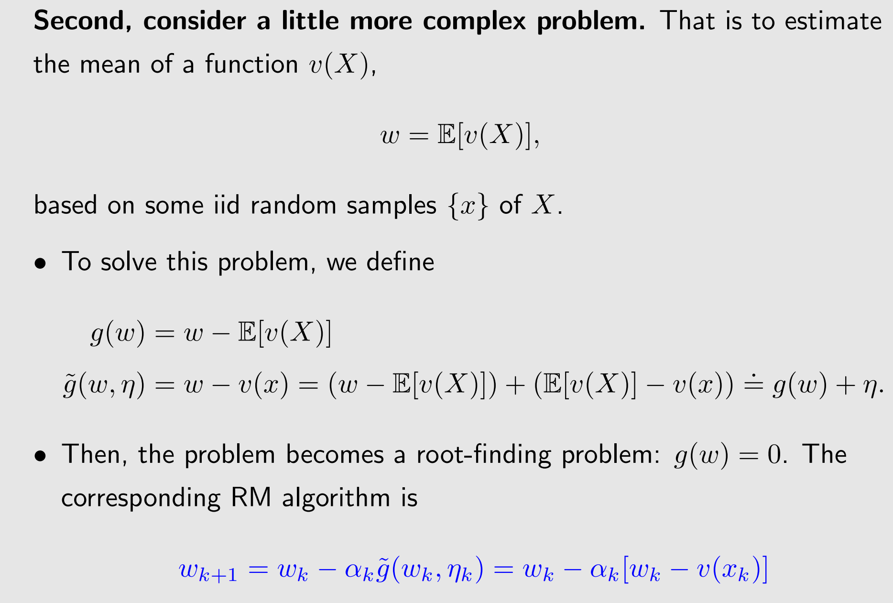
Some complex example: stochastic algorithms

Slide 12
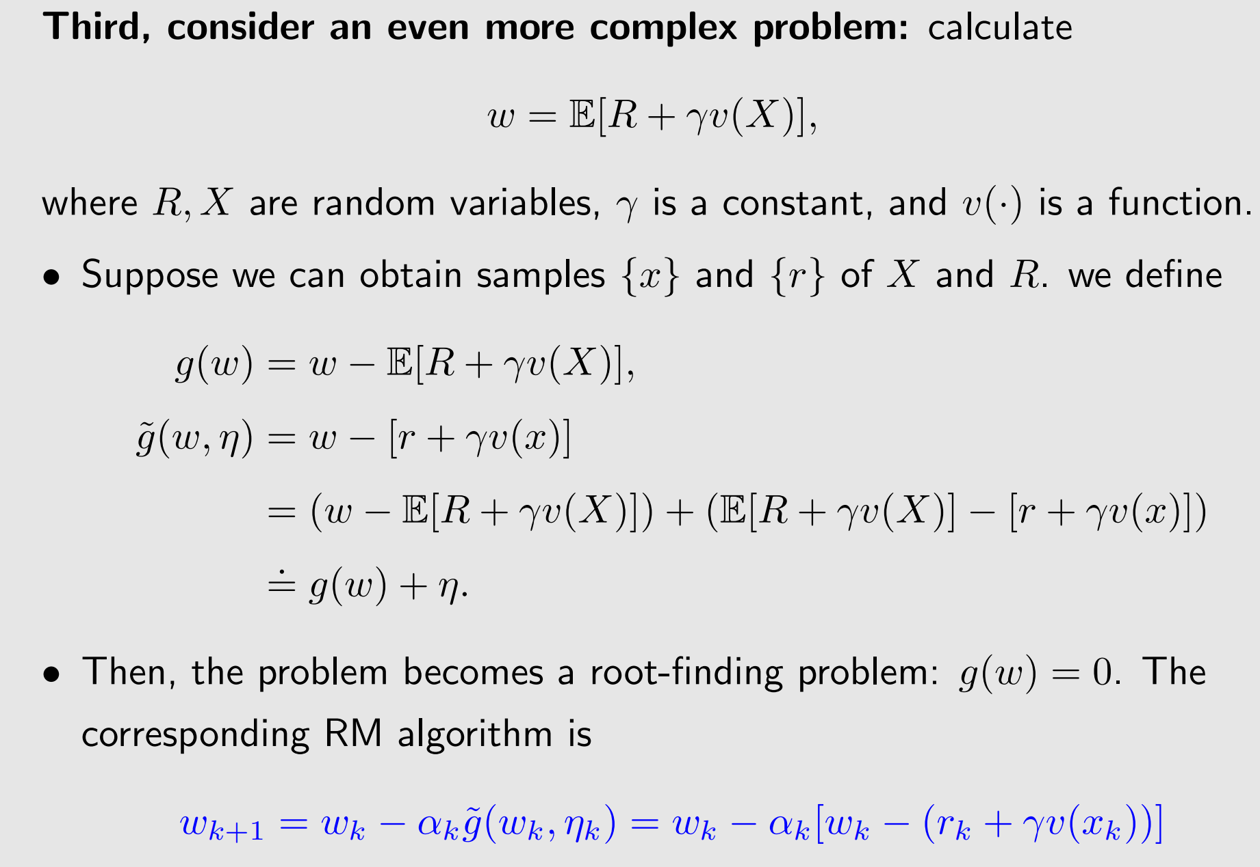
Complex example: stochastic algorithms

Slide 13
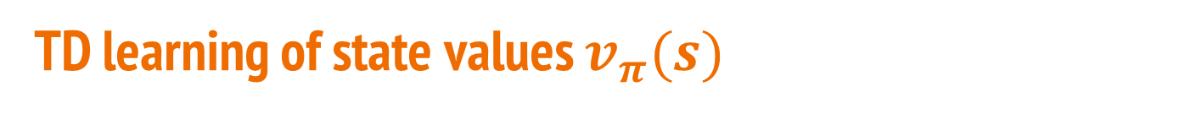
TD learning of state values $v_{π}(s)$
Note that
TD learning often refers to a broad class of RL algorithms.
TD learning also refers to a specific algorithm for estimating state values as introduced below

Slide 14
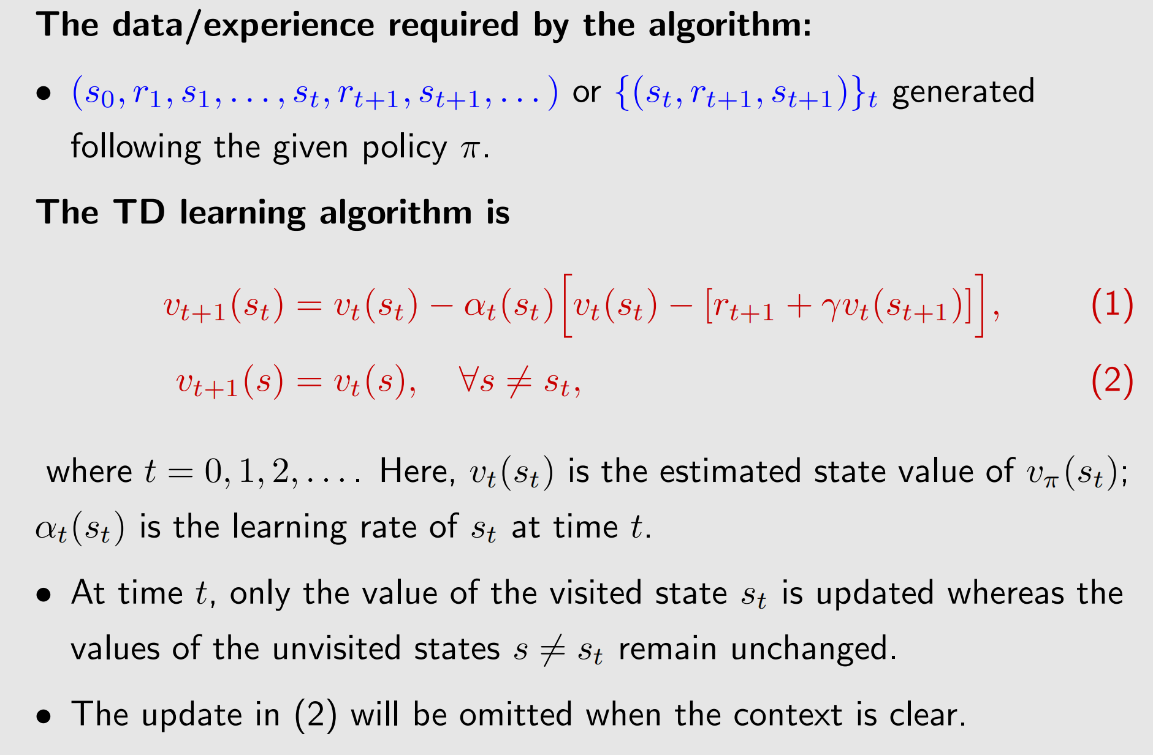
TD learning of state values – Algorithm Description
给定策略生成的数据集合
给定策略生成的数据集合

Slide 15
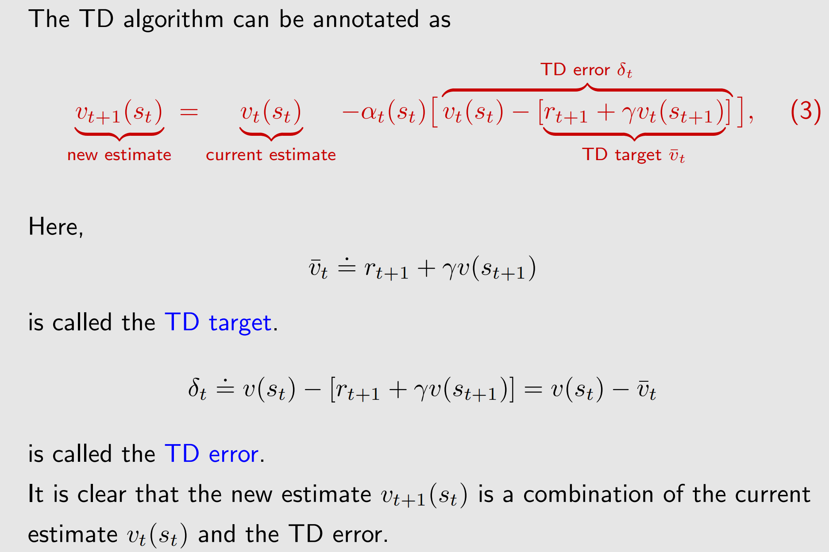
TD learning of state values – Algorithm Description

Slide 16
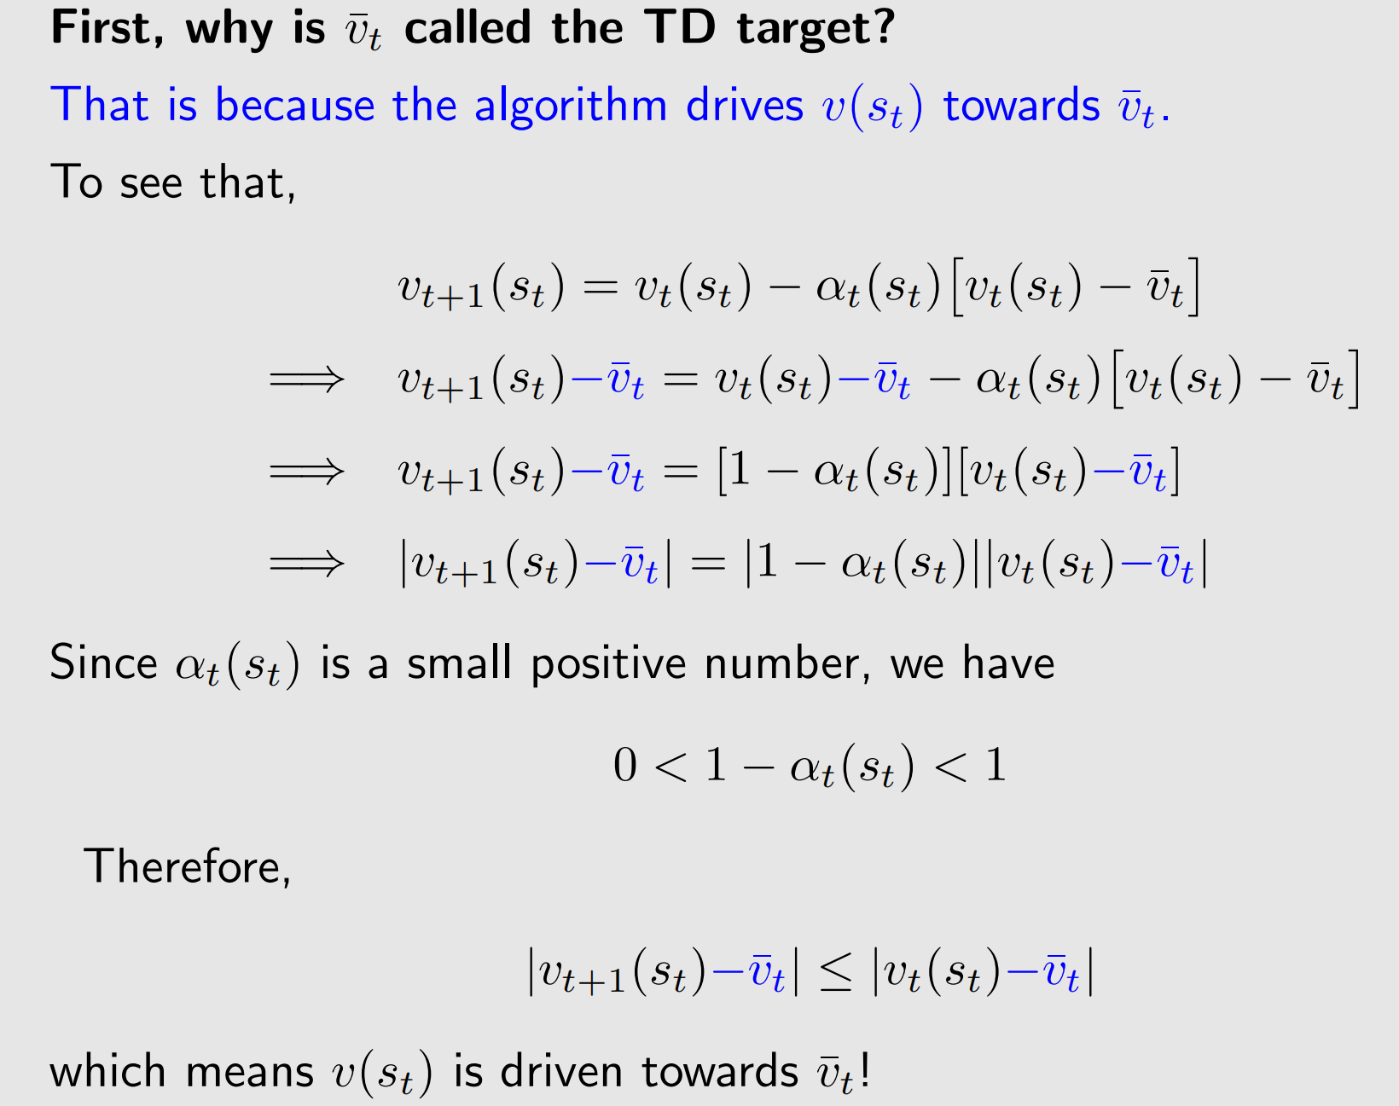
TD learning of state values – Algorithm Description

Slide 17
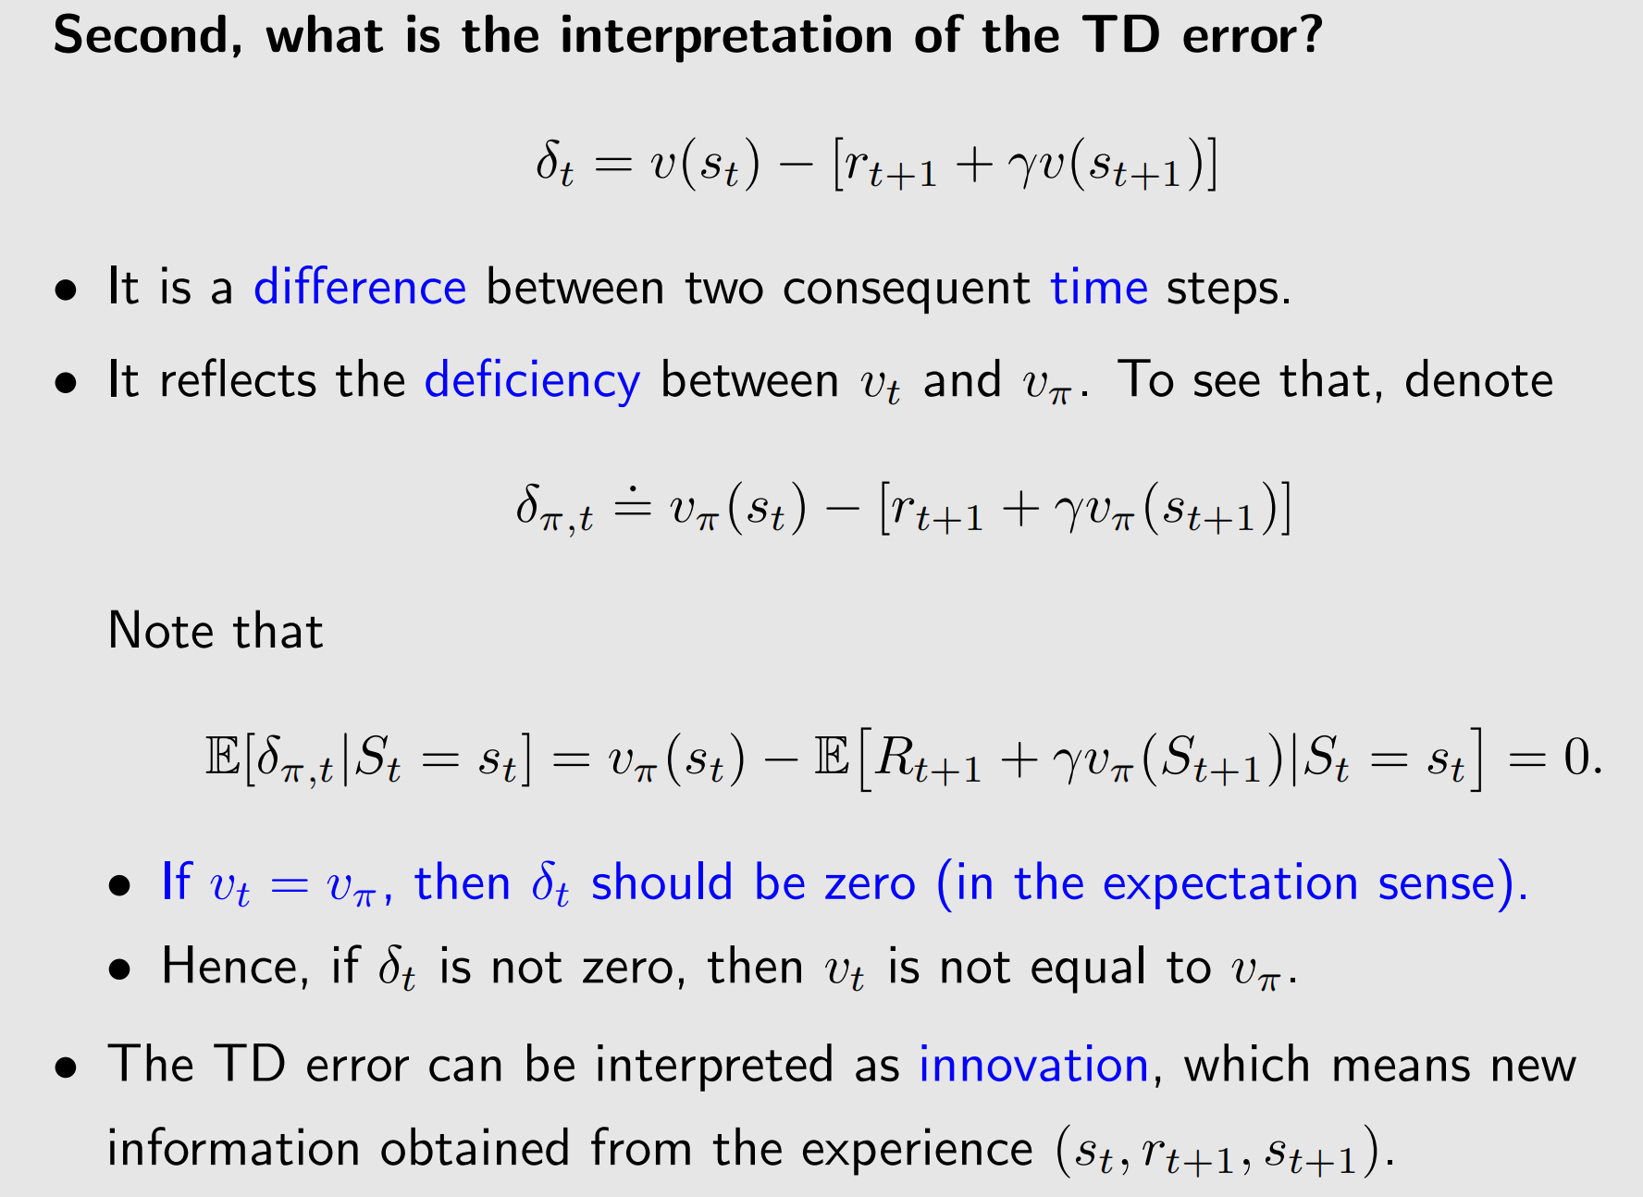
TD learning of state values – Algorithm Description
当前估计和估计的目标
新信息

Slide 18
TD learning of state values – Algorithm Properties
Other properties:
The TD algorithm in (3) only estimates the state value of a given policy.
It can do policy evaluation
It does not estimate the action values.
It does not search for optimal policies.
the TD algorithm in (3) is fundamental for understanding the core idea
Next to see how to estimate action values and then search for optimal policies.

Slide 19
TD learning of state values – The idea of the algorithm
Q: What does this TD algorithm do mathematically?
A: It solves the Bellman equation of a given policy π 在没有模型的情况下！

Slide 20
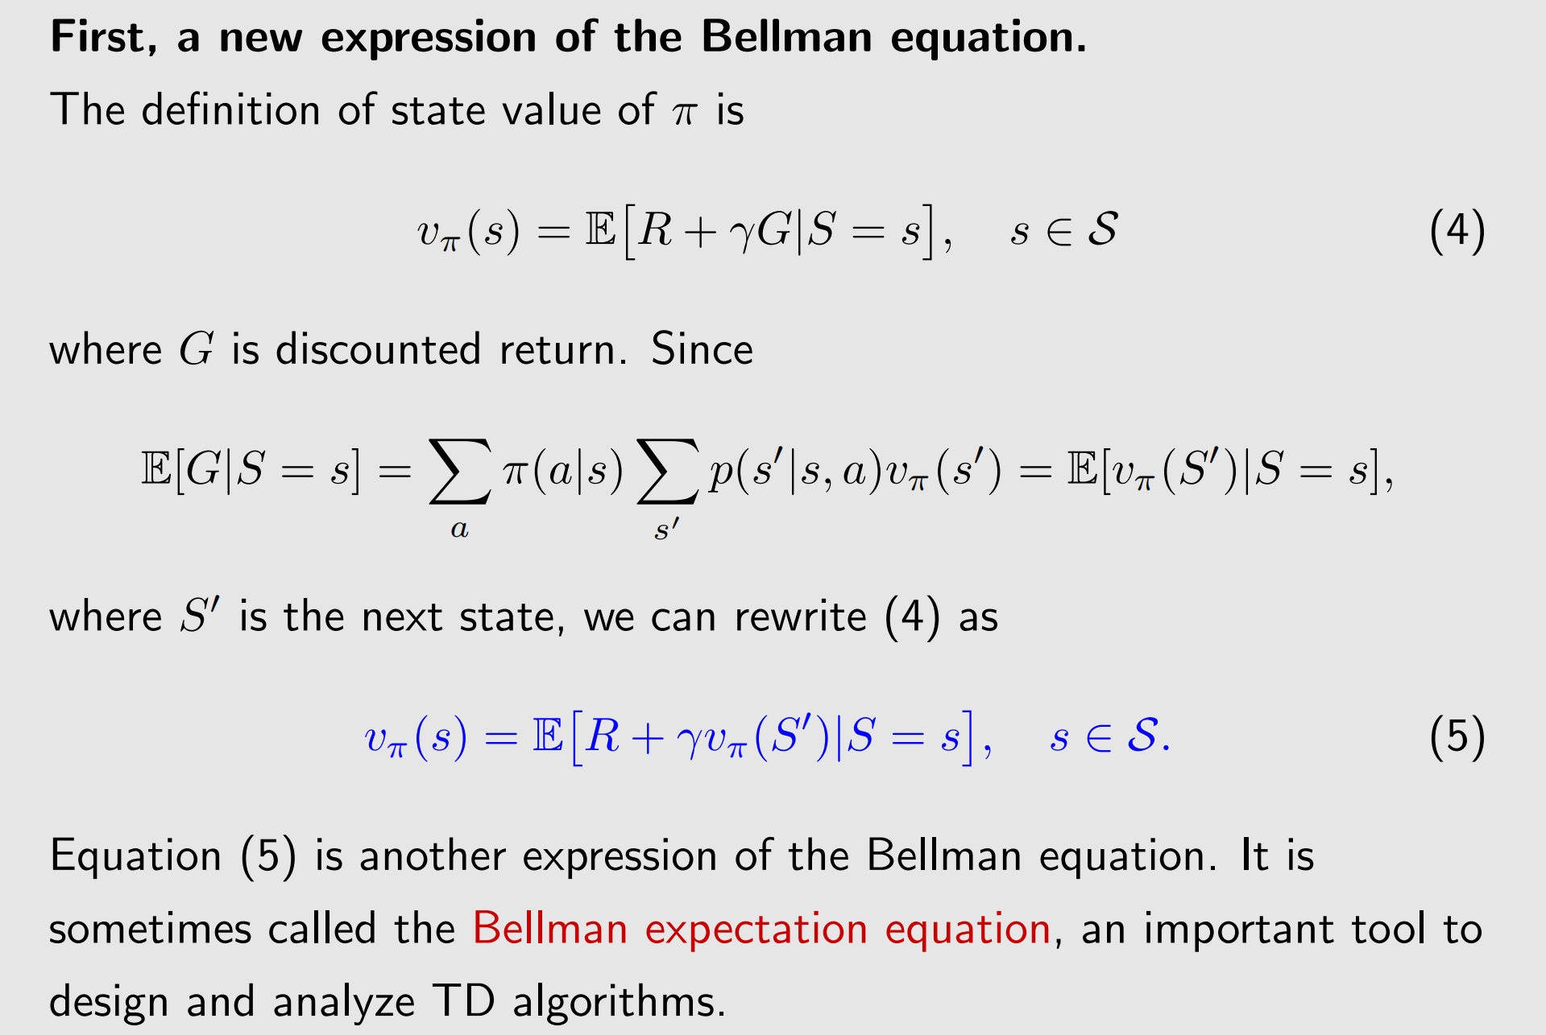
TD learning of state values – The idea of the algorithm

Slide 21
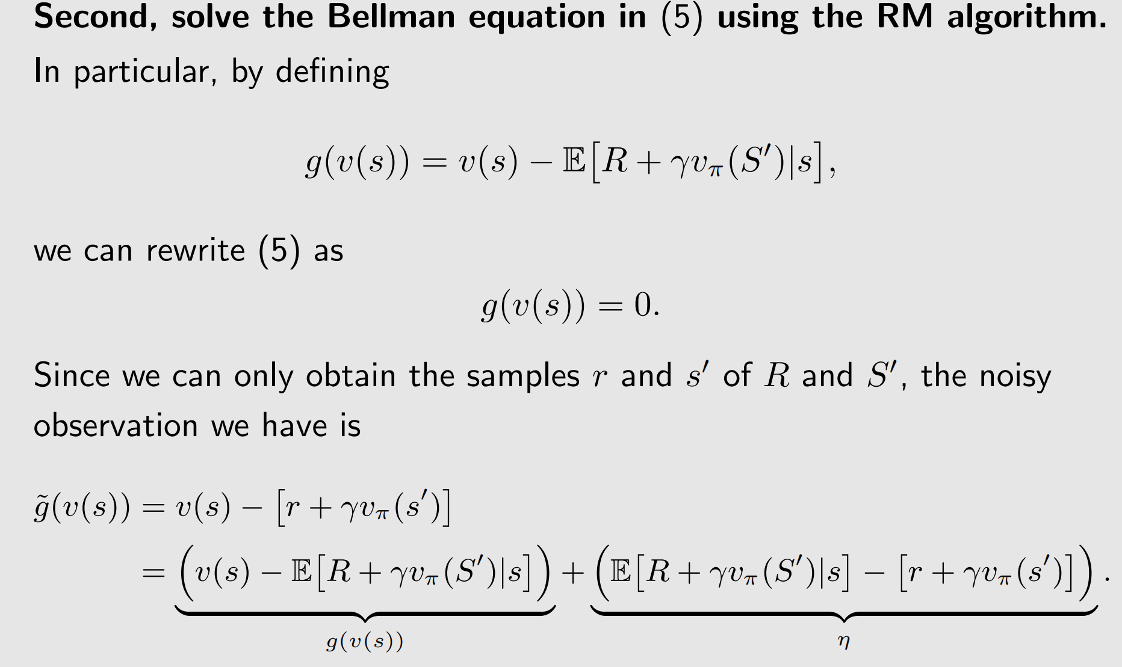
TD learning of state values – The idea of the algorithm

Slide 22
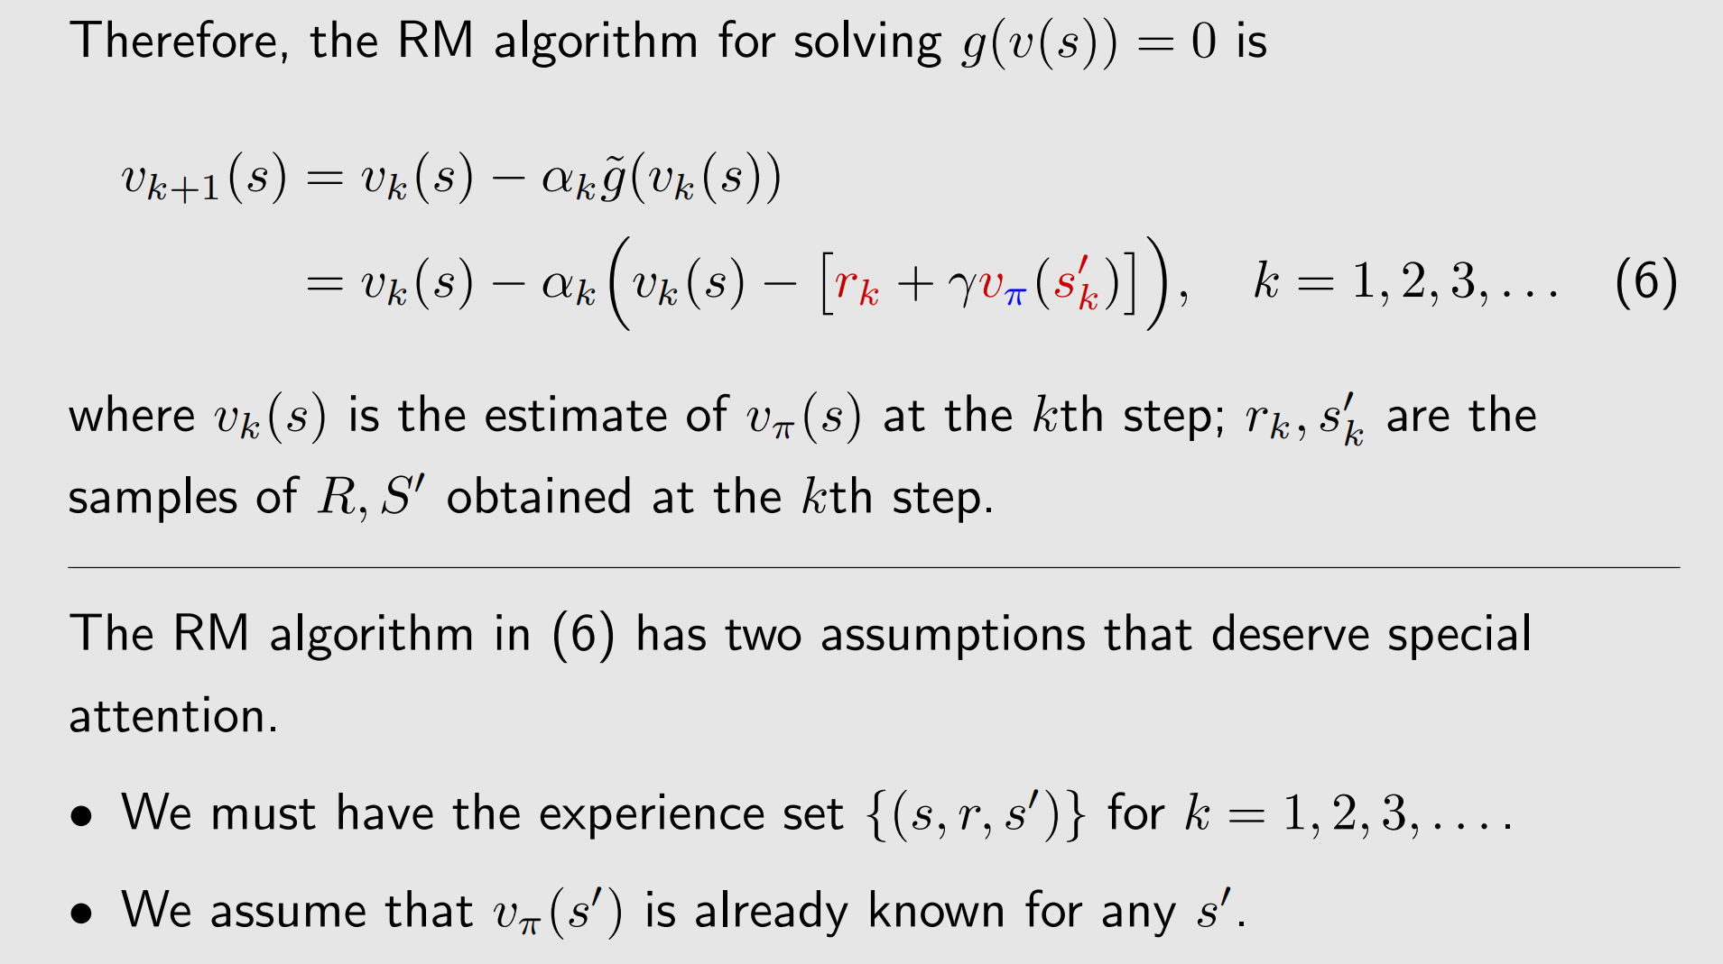
TD learning of state values – The idea of the algorithm

Slide 23
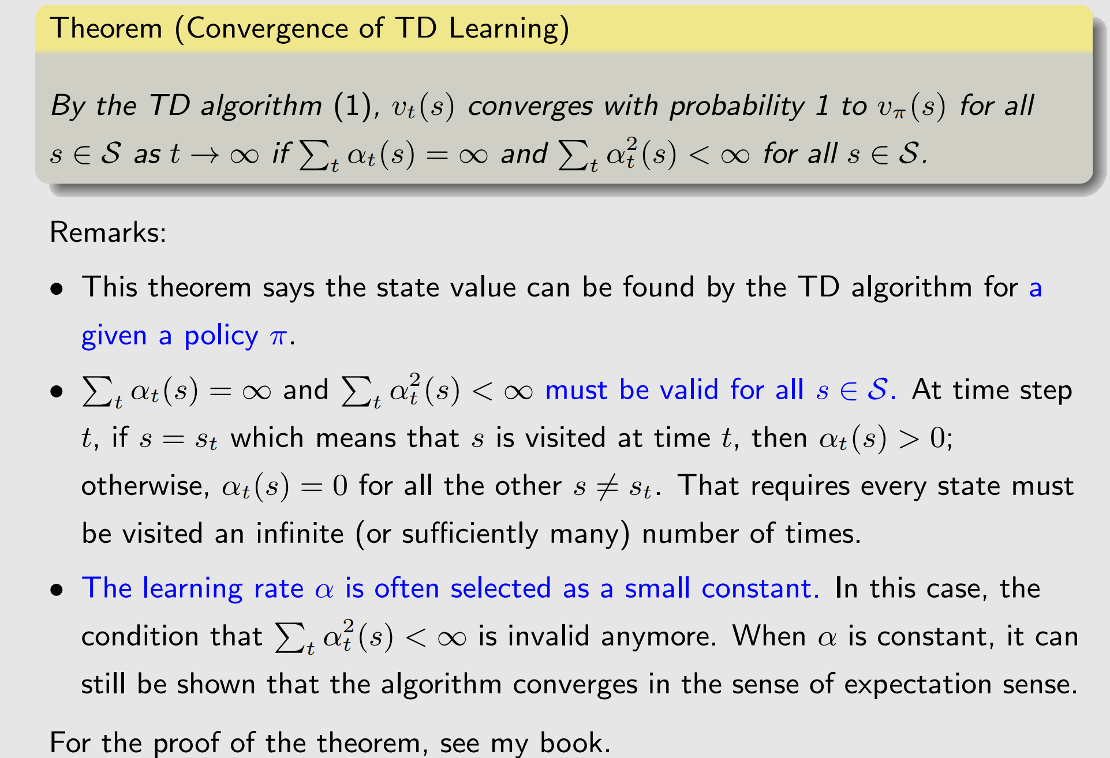
TD learning of state values –Algorithm covergence

Slide 24
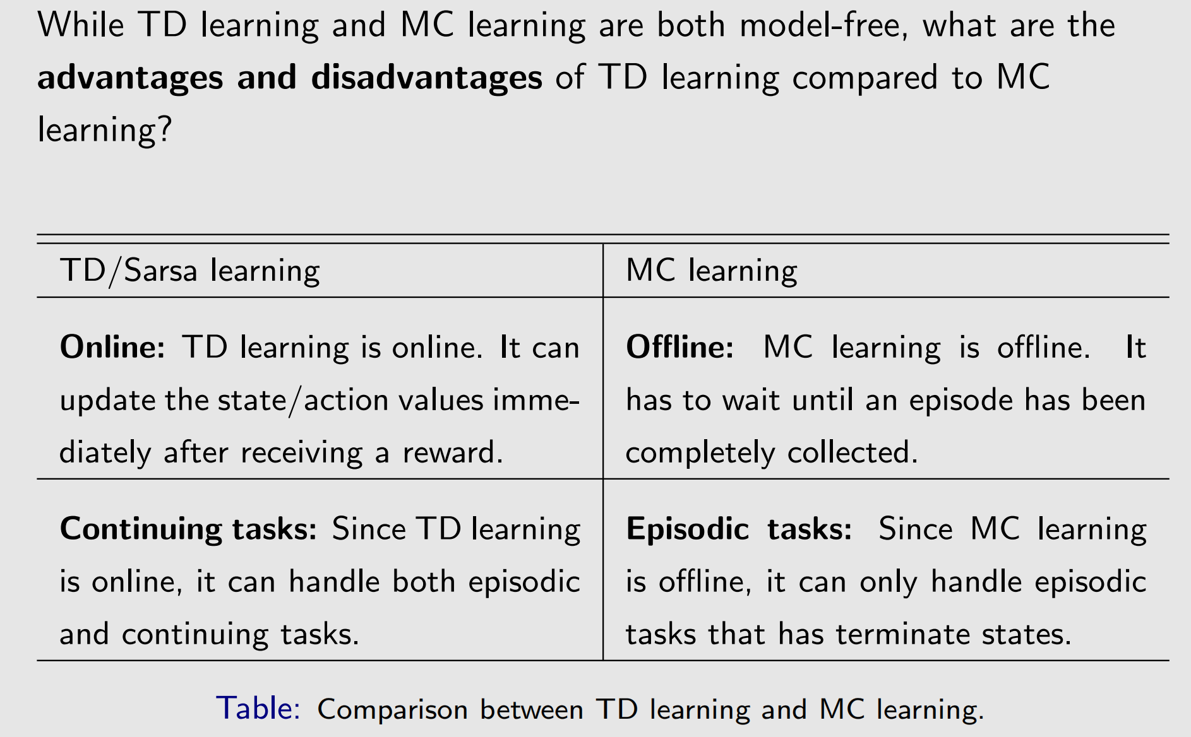
TD learning of state values –Algorithm properties

Slide 25
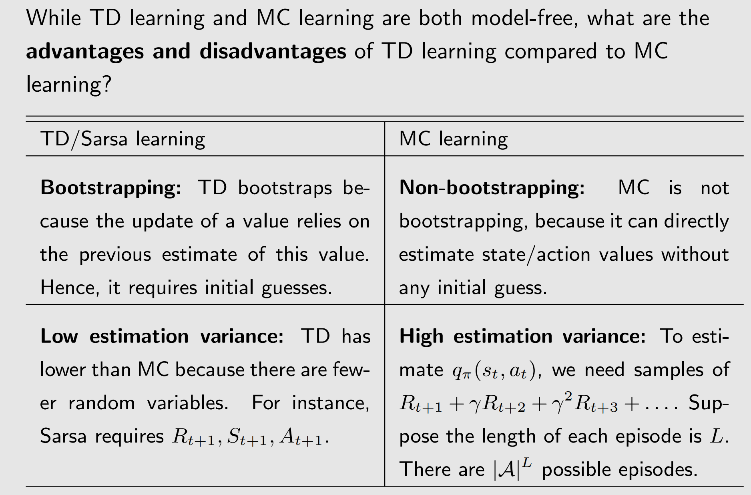
TD learning of state values –Algorithm properties

Slide 26
TD learning of action state values –Sarsa
The TD algorithm introduced in the last section can only estimate state values.
Sarsa, an algorithm that can directly estimate action values.
We will also see how to use Sarsa to find optimal policies.

Slide 27
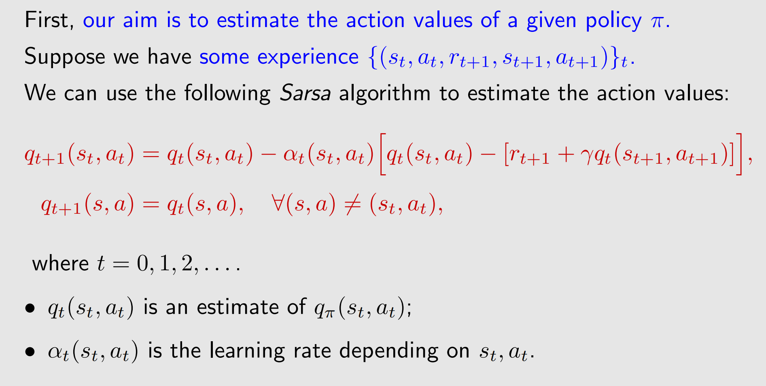
TD learning of action state values –Sarsa : Algorithm

Slide 28
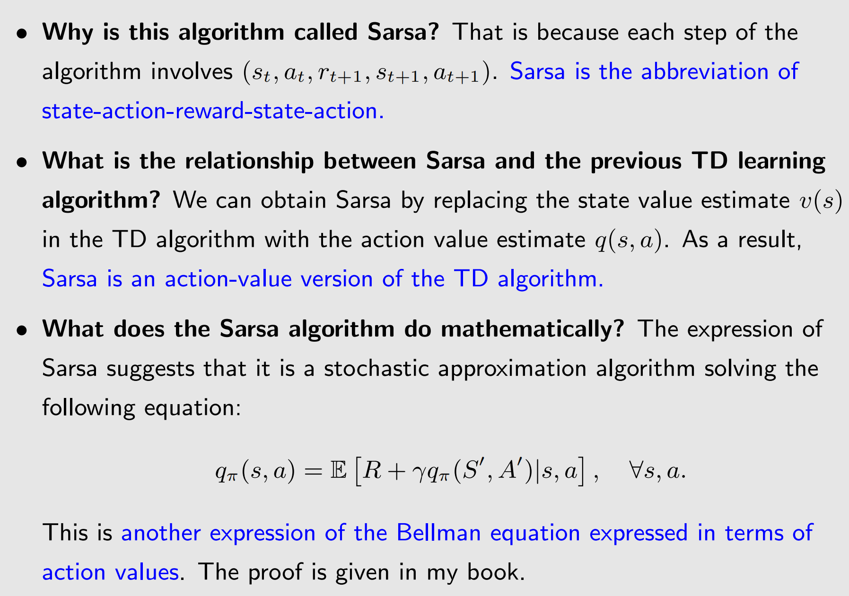
TD learning of action state values –Sarsa : Algorithm

Slide 29
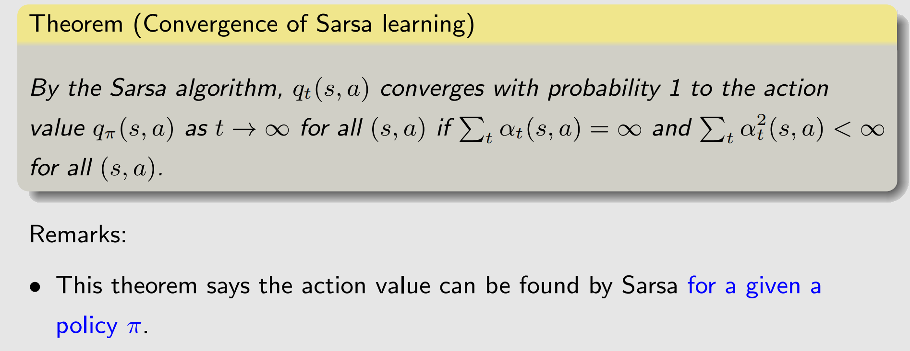
TD learning of action state values –Sarsa : Algorithm

Slide 30
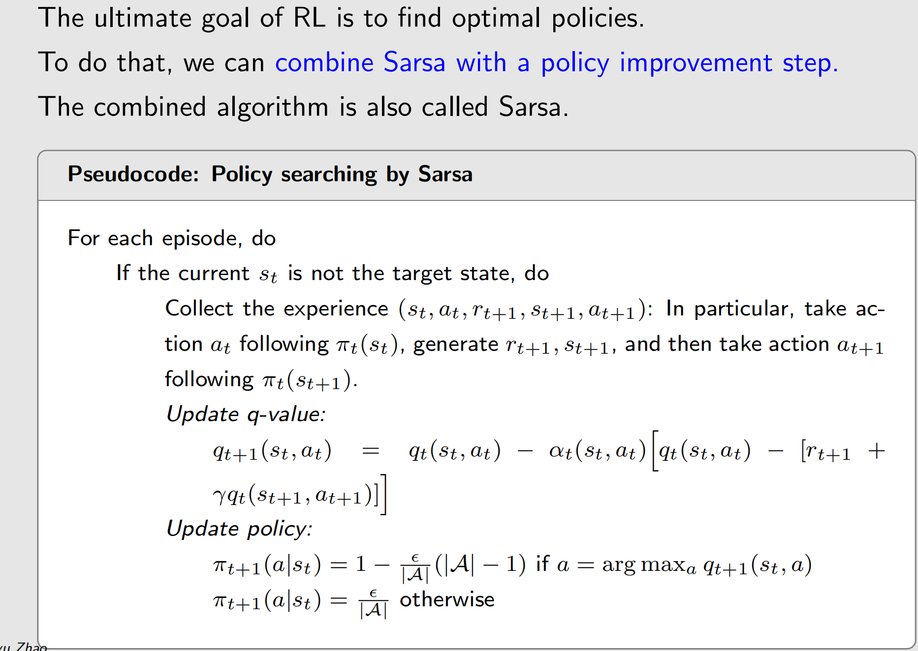
TD learning of action state values –Sarsa : Implementation

Slide 31
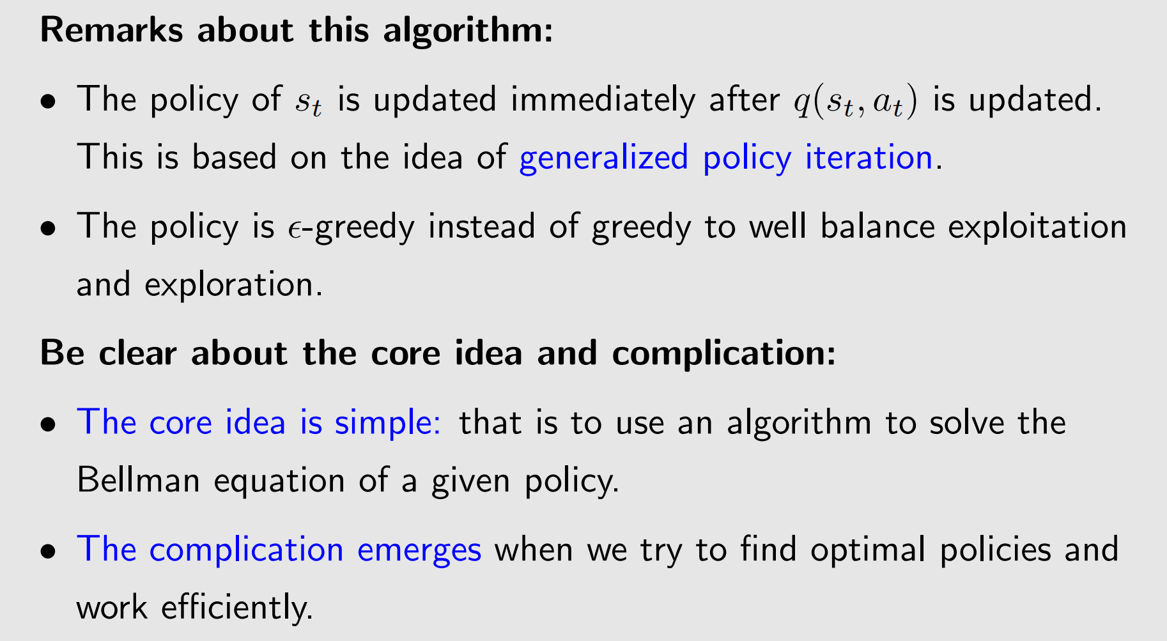
TD learning of action state values –Sarsa : Implementation

Slide 32
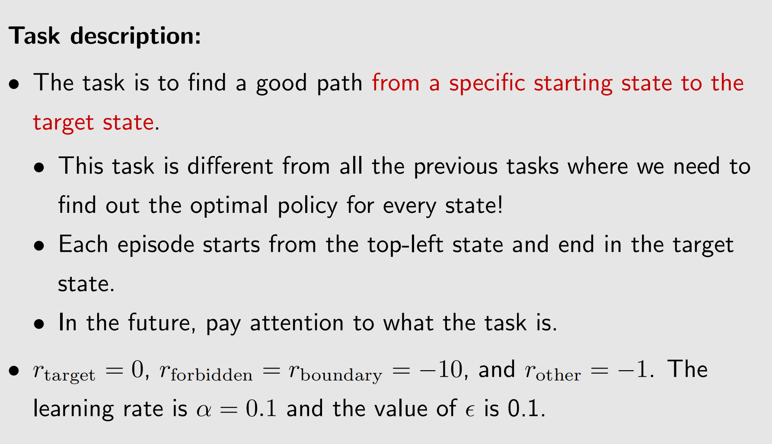
TD learning of action state values –Sarsa : Example

Slide 33
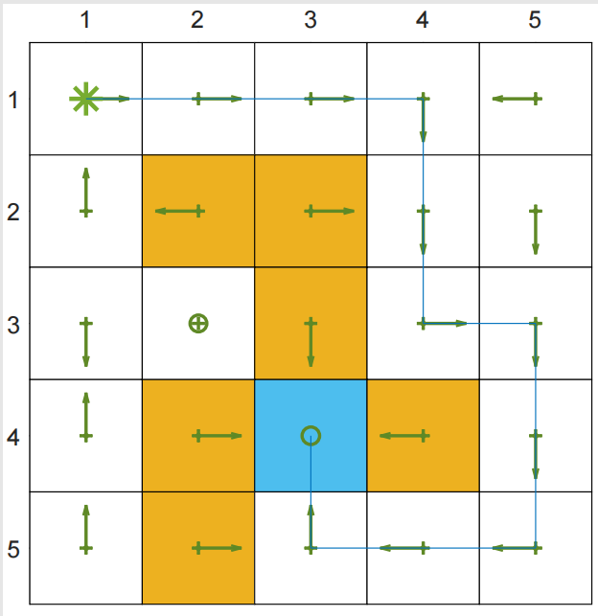
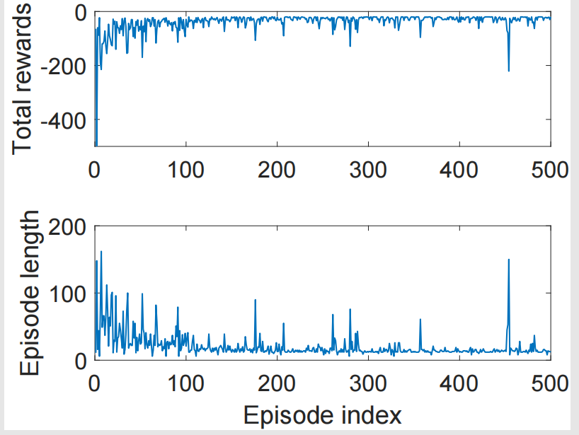
TD learning of action state values –Sarsa : Example
Results:
The left figures above show the fifinal policy obtained by Sarsa.
Not all states have the optimal policy.
The right figures show the total reward and length of every episode.
The metric of total reward per episode will be frequently used.

Slide 34
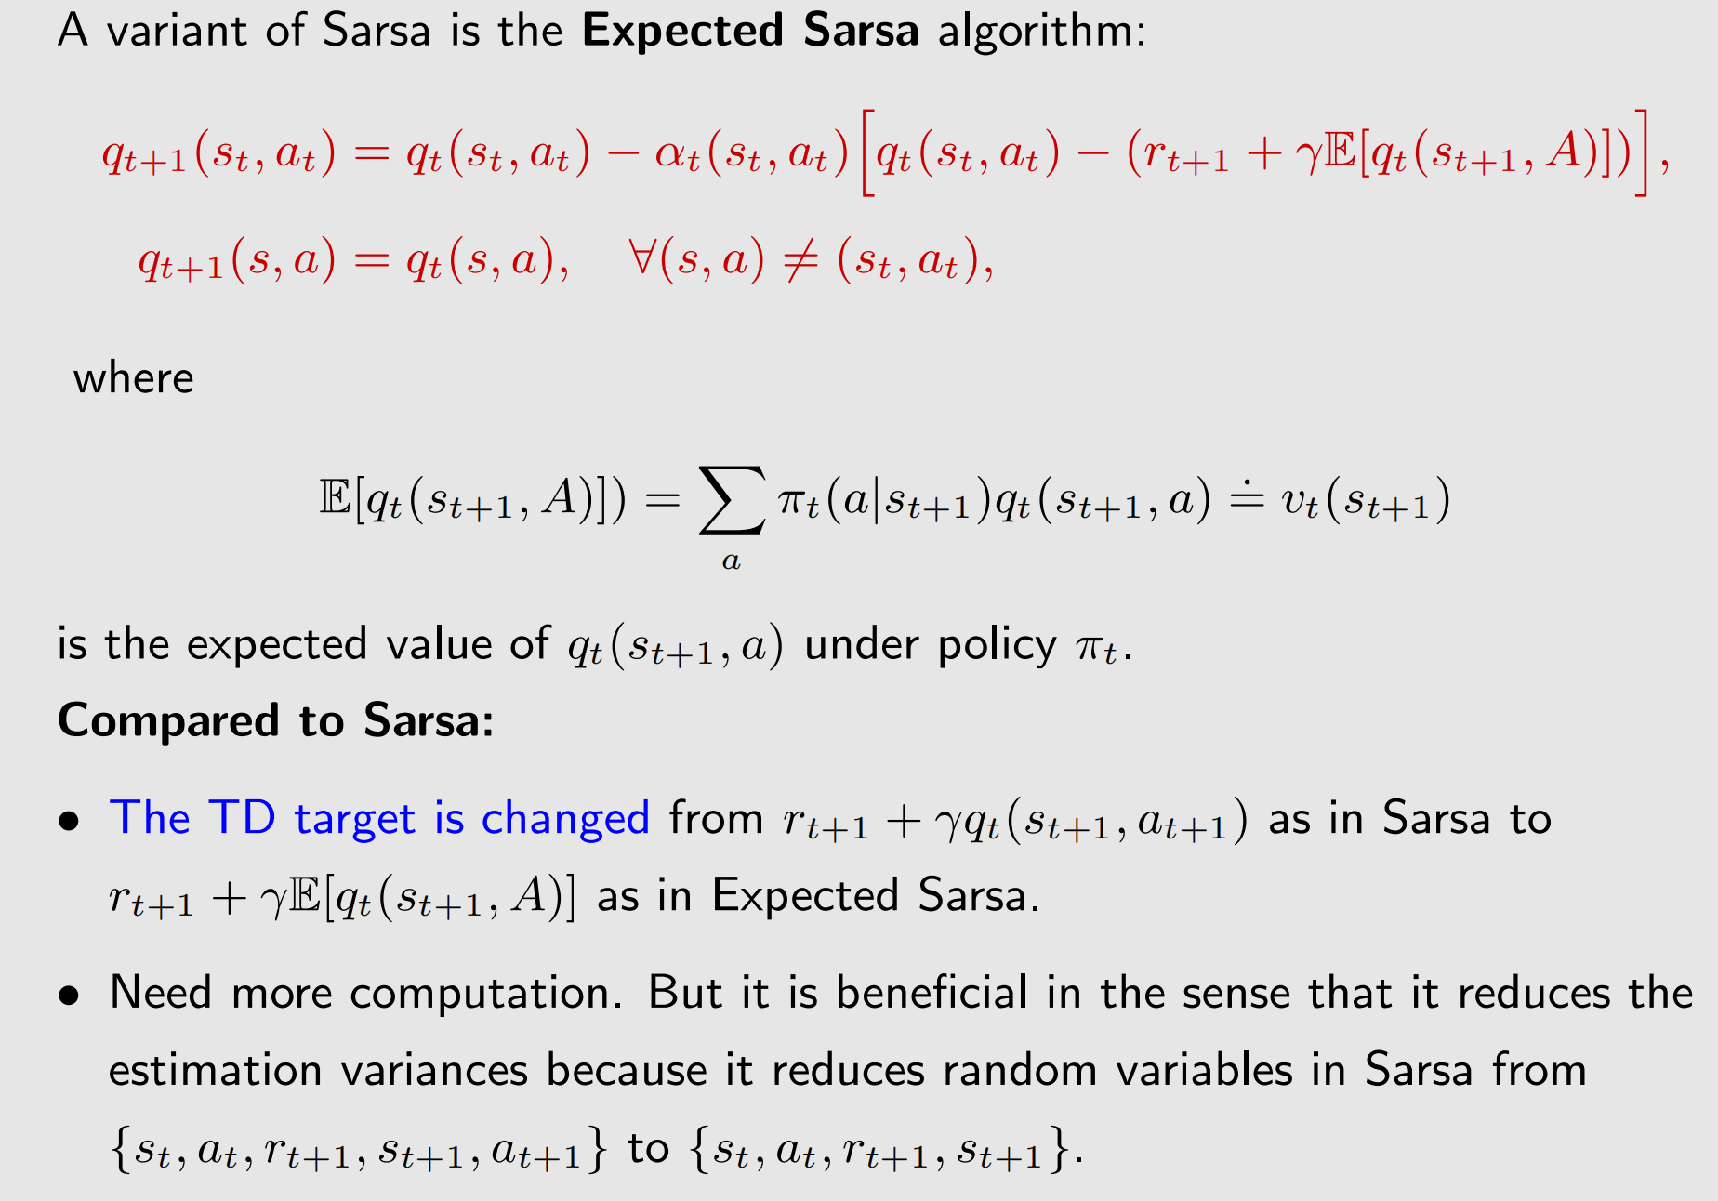
TD learning of action state values –Expected Sarsa

Slide 35
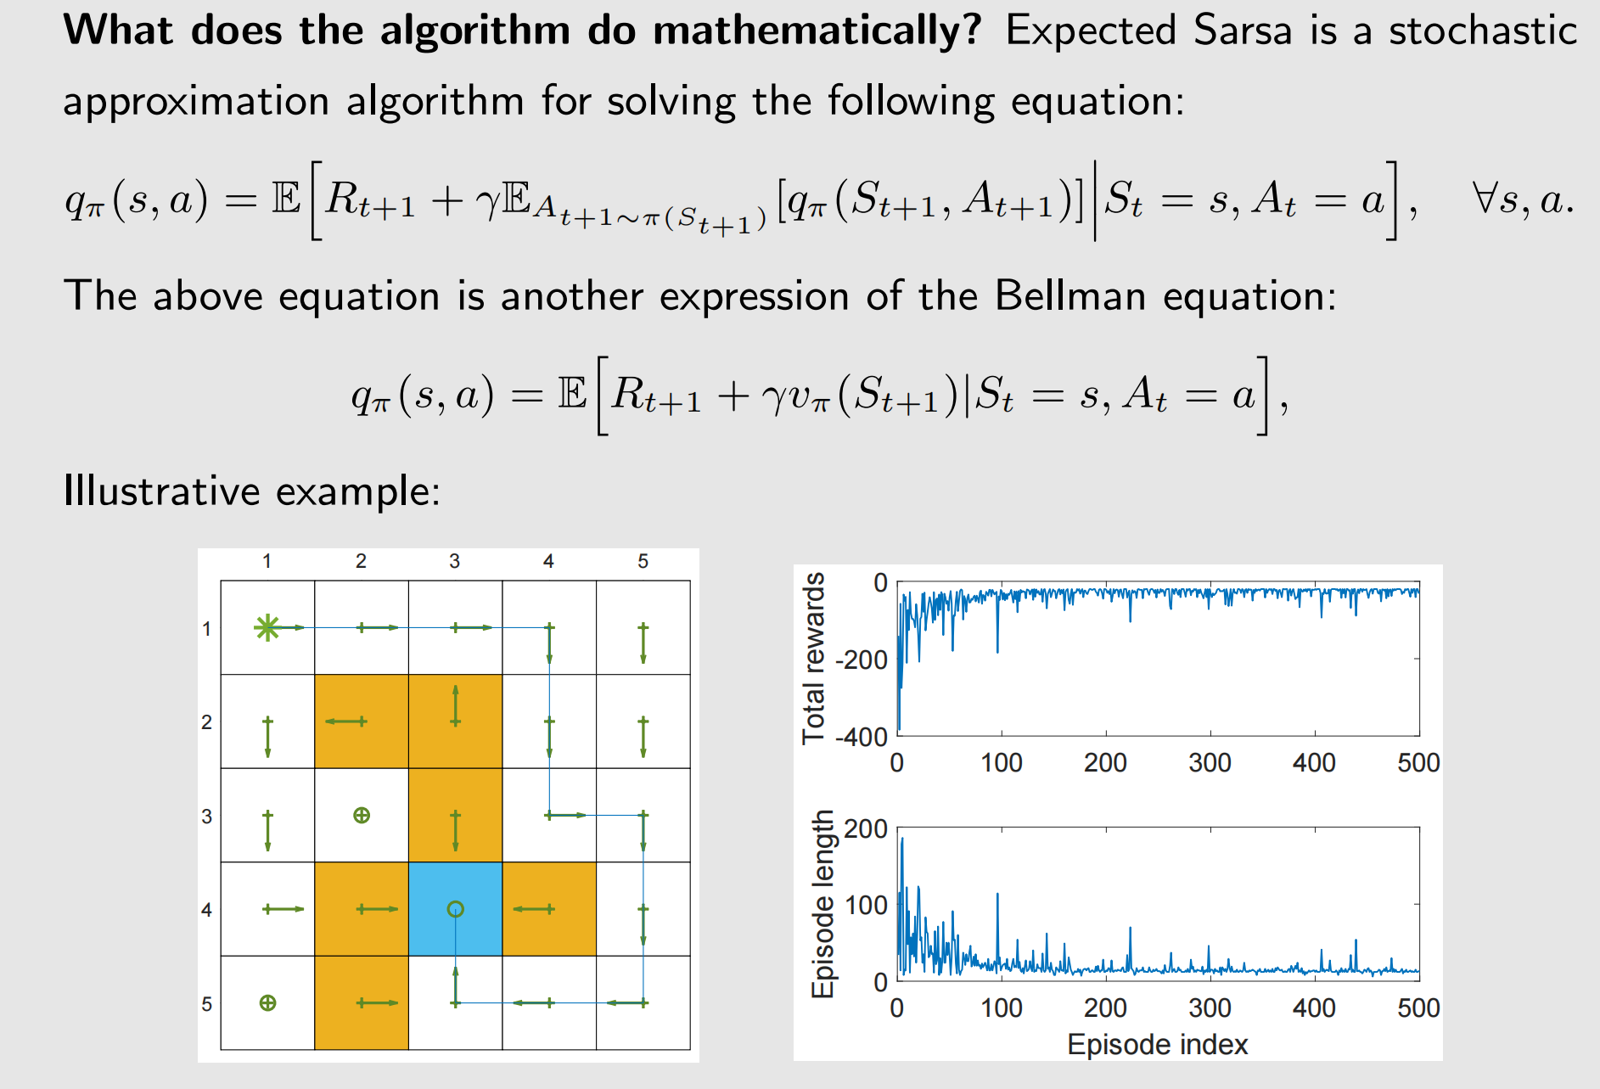
TD learning of action state values –Expected Sarsa

Slide 36
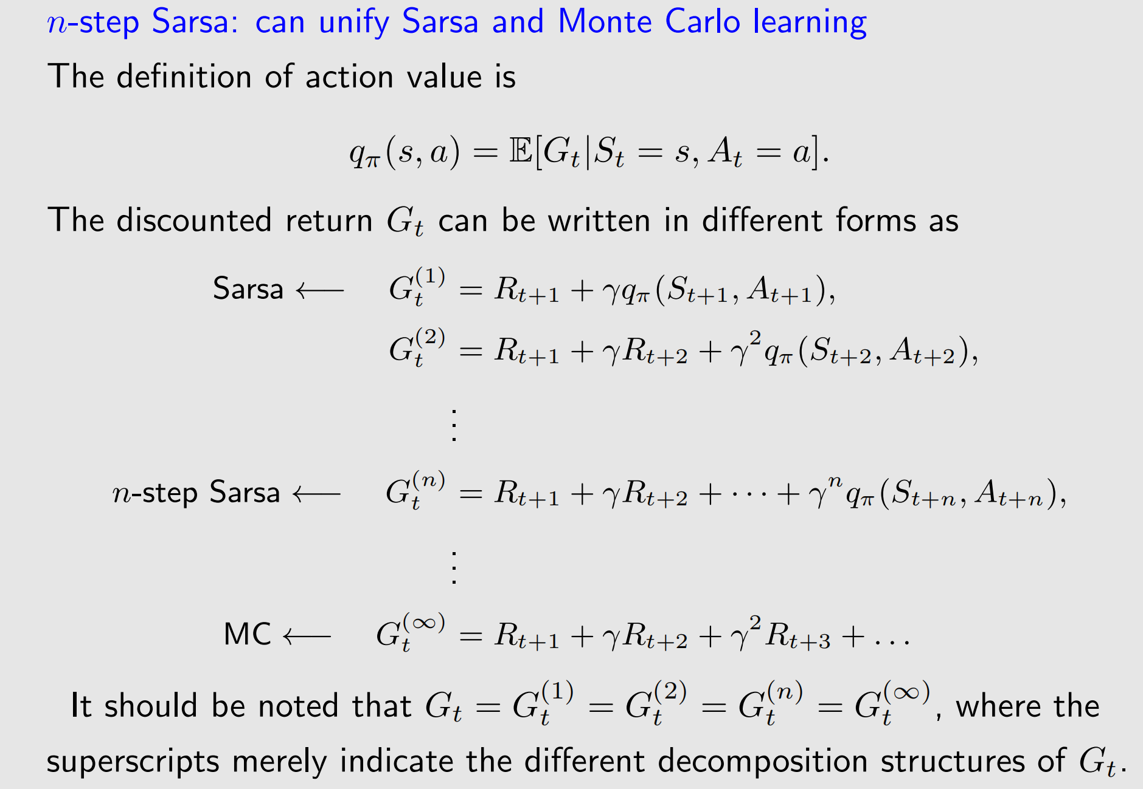
TD learning of action state values – n-step Sarsa

Slide 37
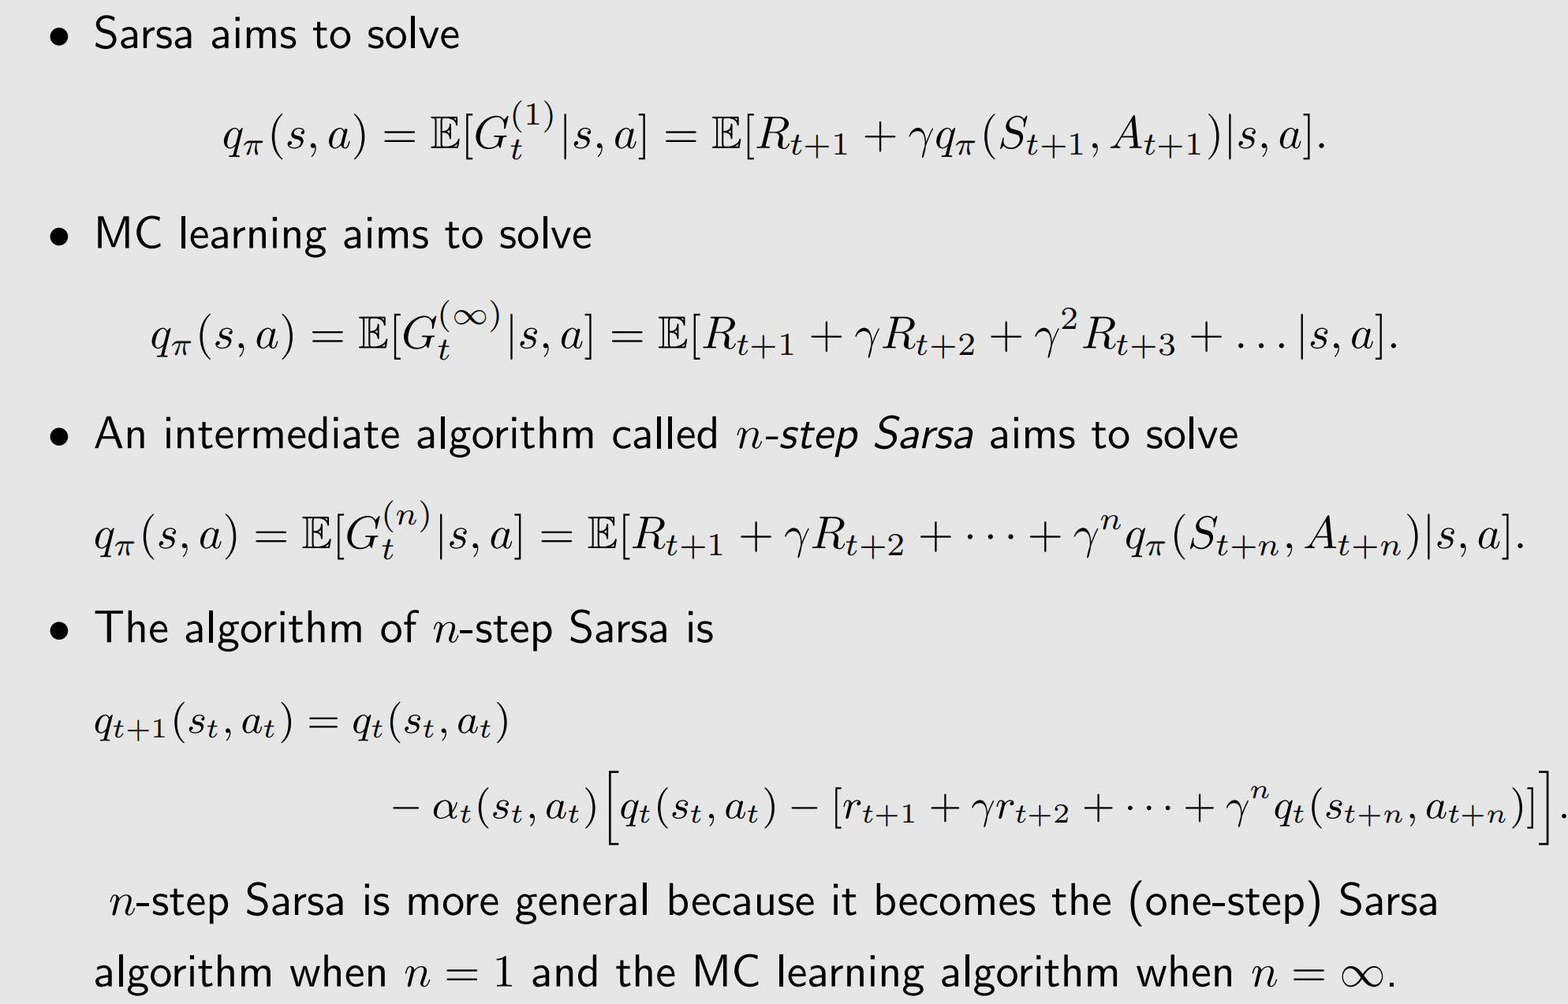
TD learning of action state values – n-step Sarsa

Slide 38
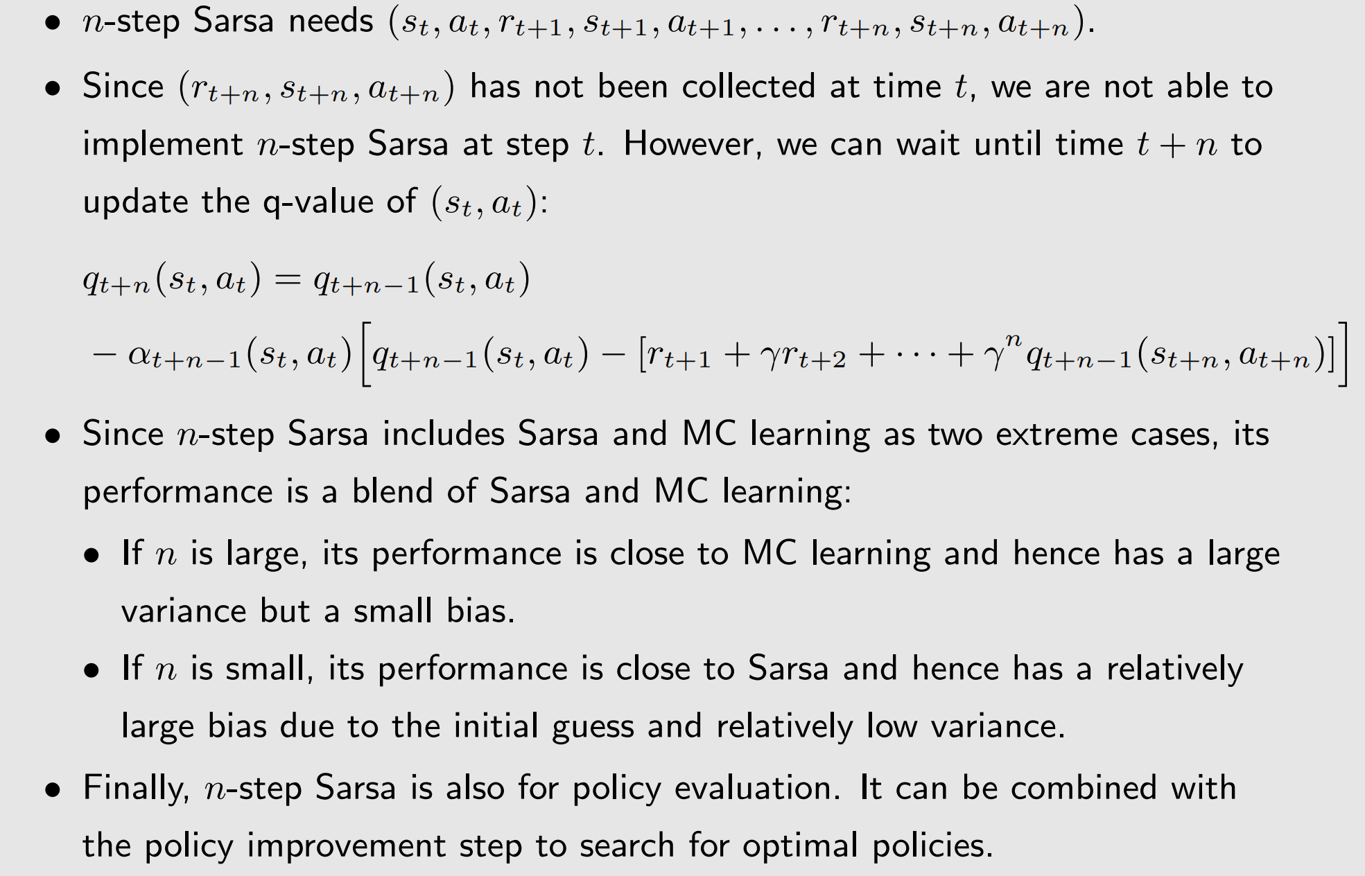
TD learning of action state values – n-step Sarsa

Slide 39
TD learning of optimal action values : Q-Learning
Q-learning, one of the most widely used RL algorithms.
Sarsa can estimate the action values of a given policy. It must be combined with a policy improvement step to find optimal policies.
Q-learning can directly estimate optimal action values and hence optimal policies.

Slide 40
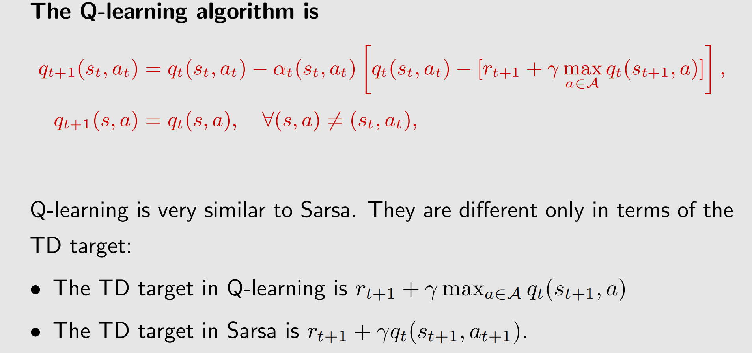
TD learning of of action values : Q-Learning-Algorithm

Slide 41
TD learning of of action values : Q-Learning-Algorithm
What does Q-learning do mathematically?
It aims to solve
This is the Bellman optimality equation expressed in terms of action values.

Slide 42
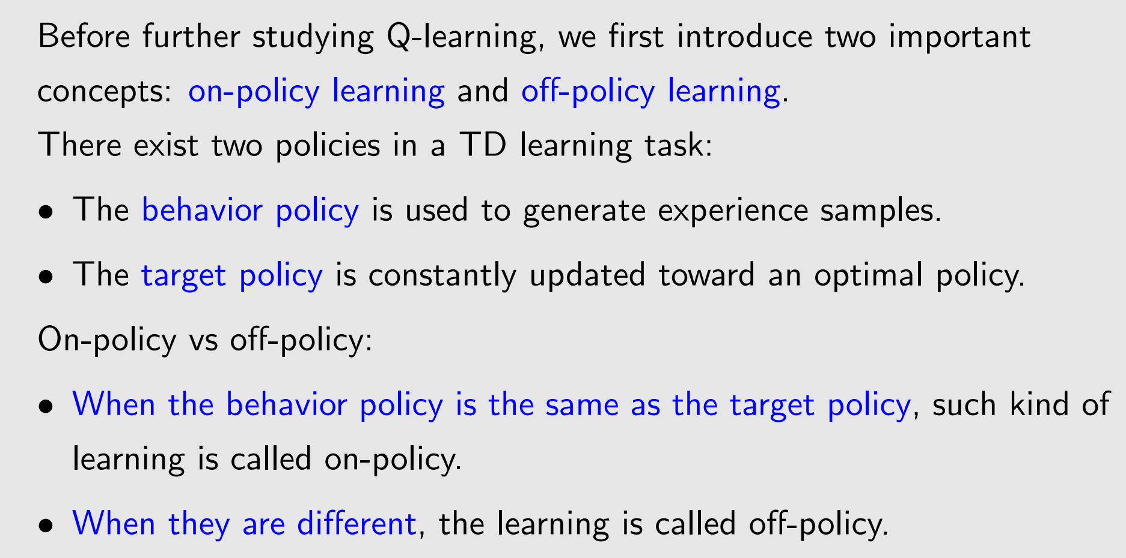
Off-policy vs on-policy

Slide 43
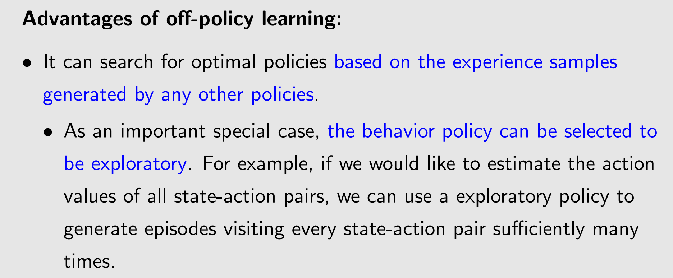
Off-policy vs on-policy

Slide 44
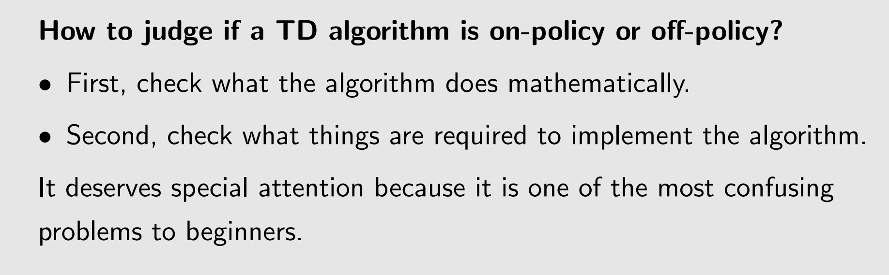
Off-policy vs on-policy

Slide 45
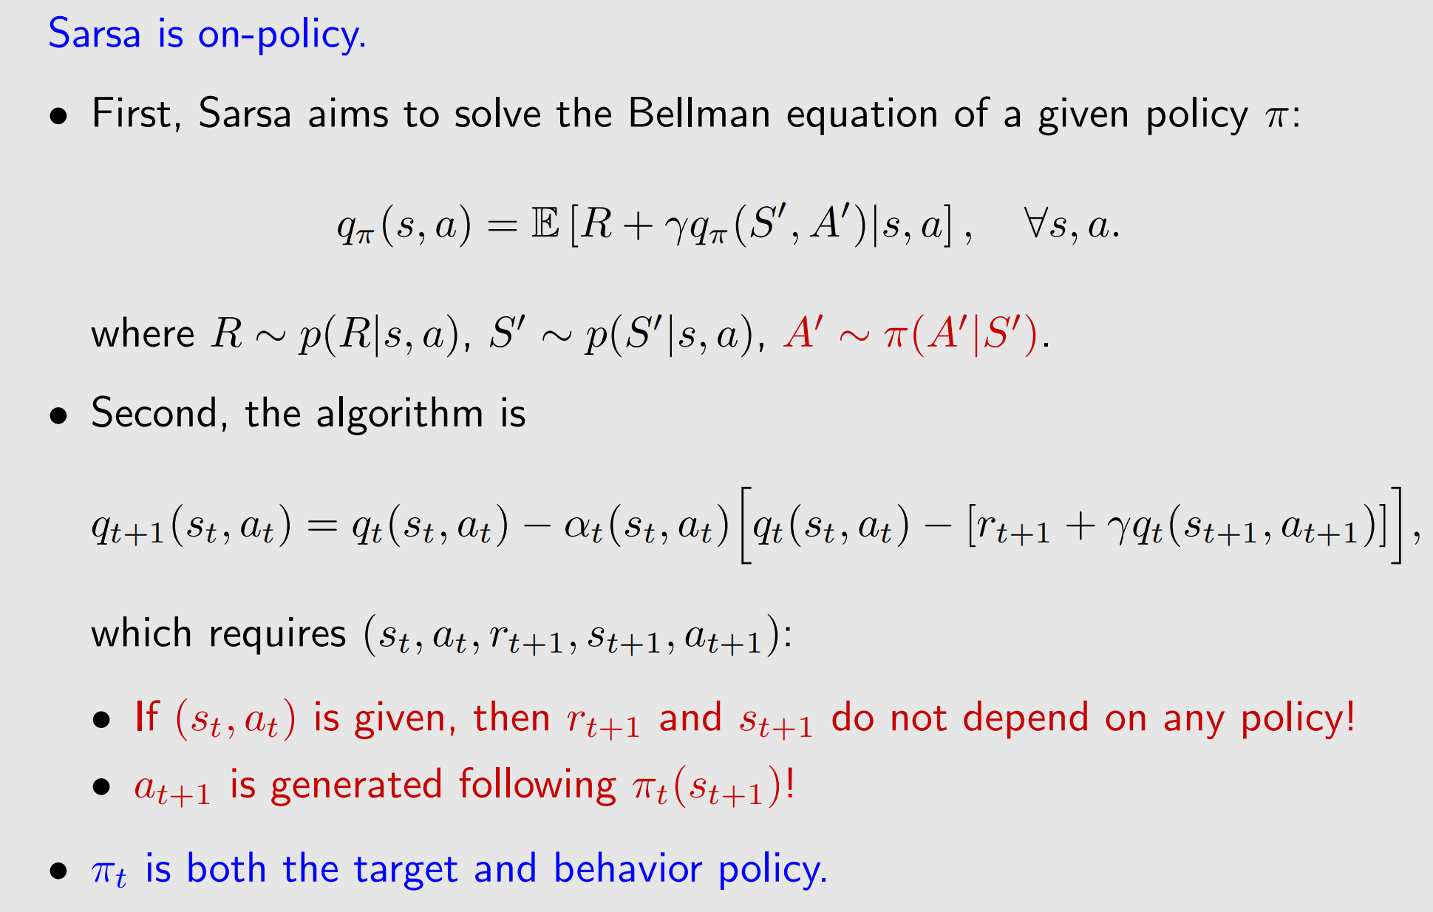
Off-policy vs on-policy

Slide 46
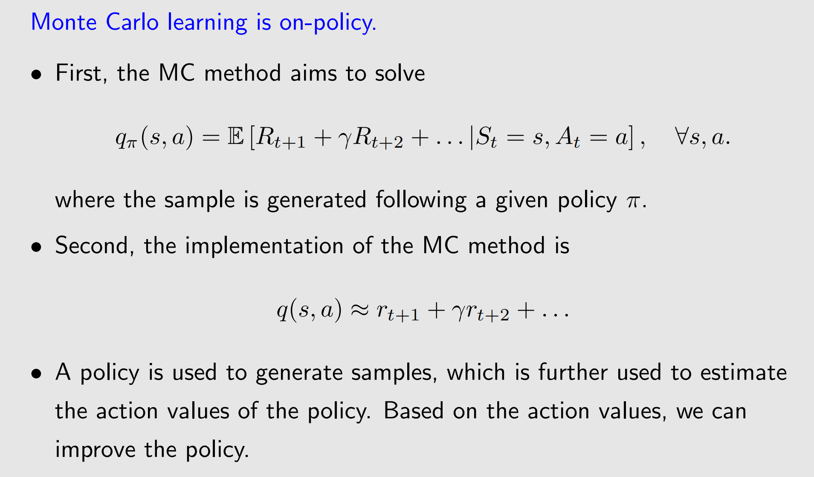
Off-policy vs on-policy

Slide 47
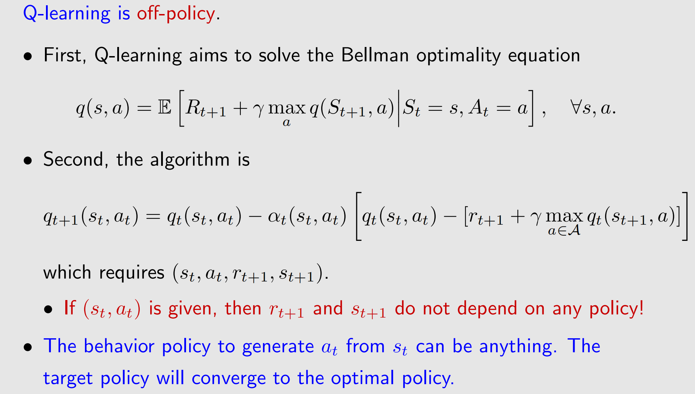
Off-policy vs on-policy

Slide 48
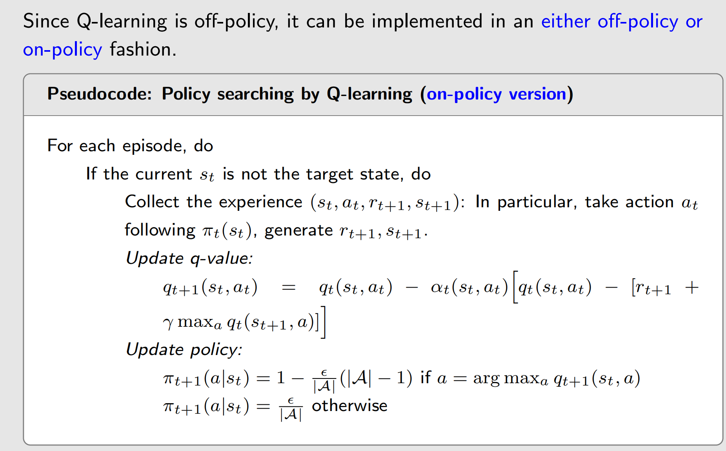
Q-Learning - Implementation

Slide 49
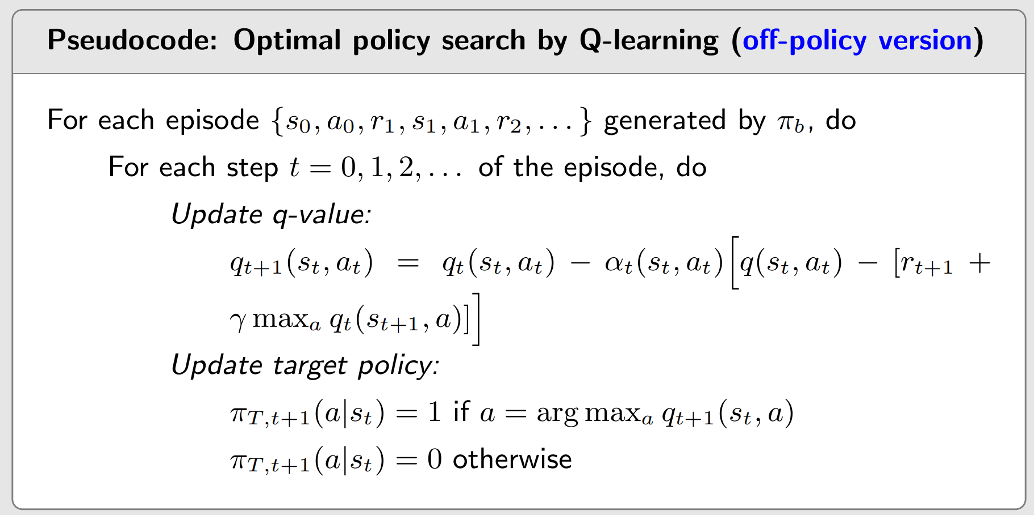
Q-Learning - Algorithm

Slide 50
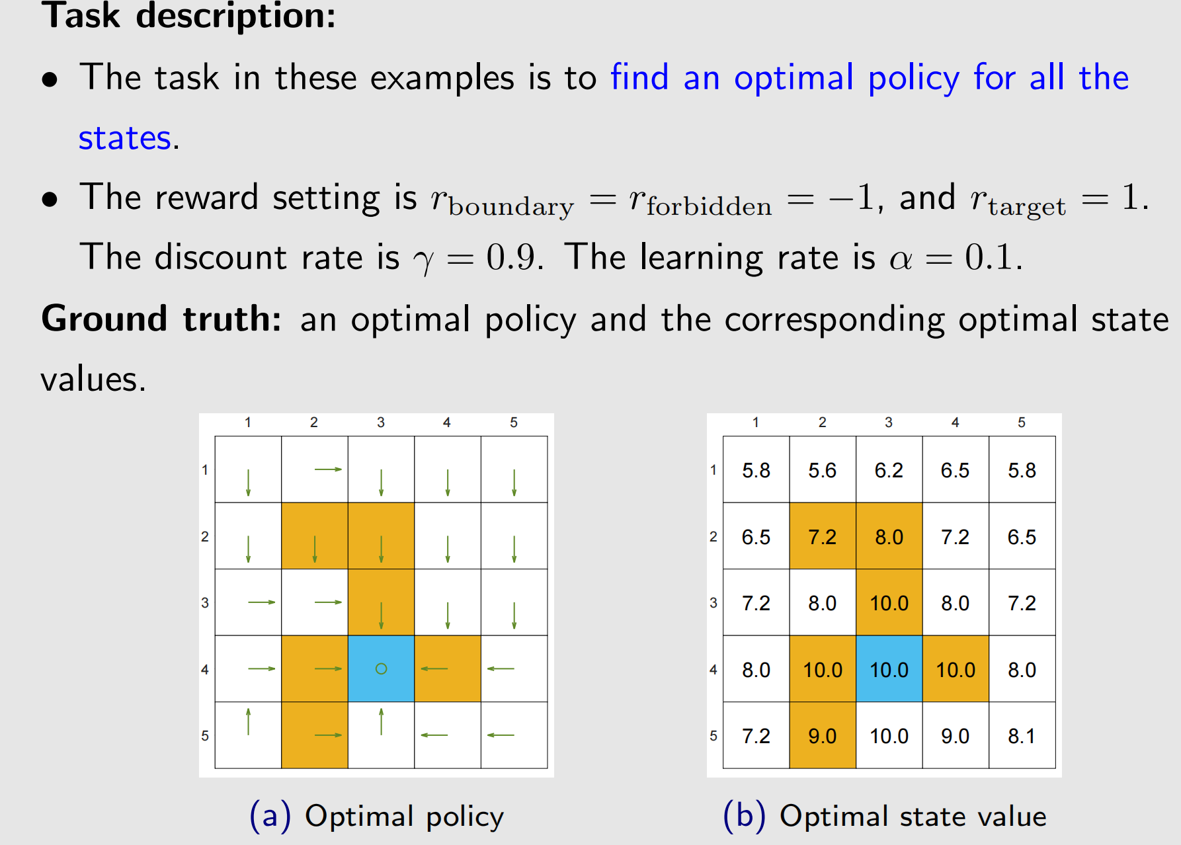
Q-Learning - Examples

Slide 51
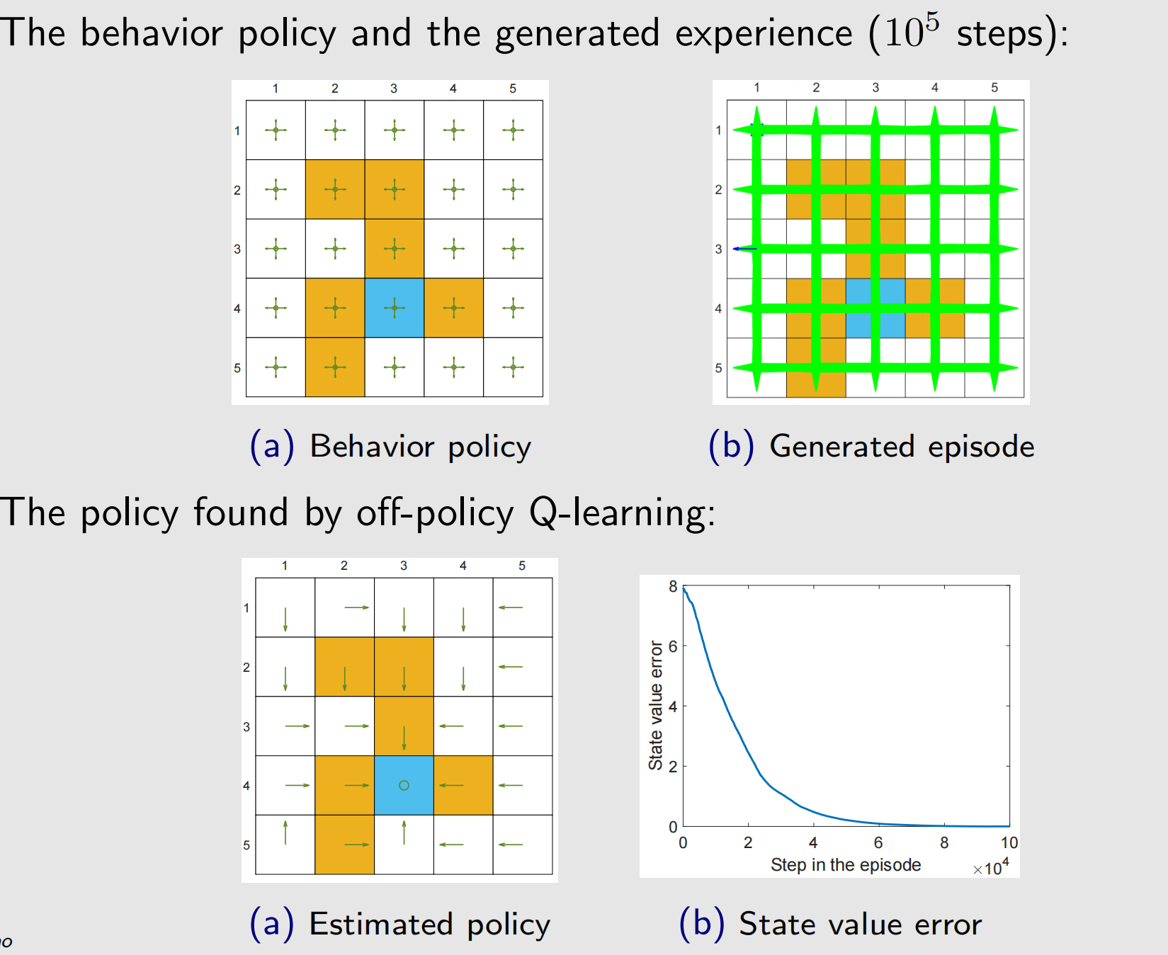
Q-Learning - Examples

Slide 52
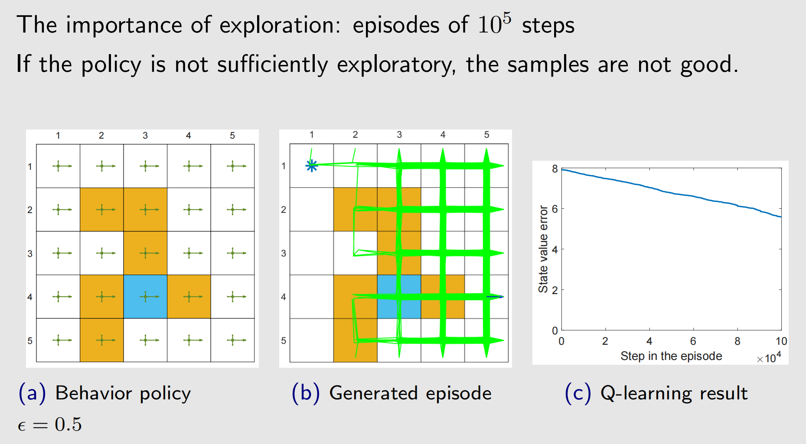
Q-Learning - Examples

Slide 53
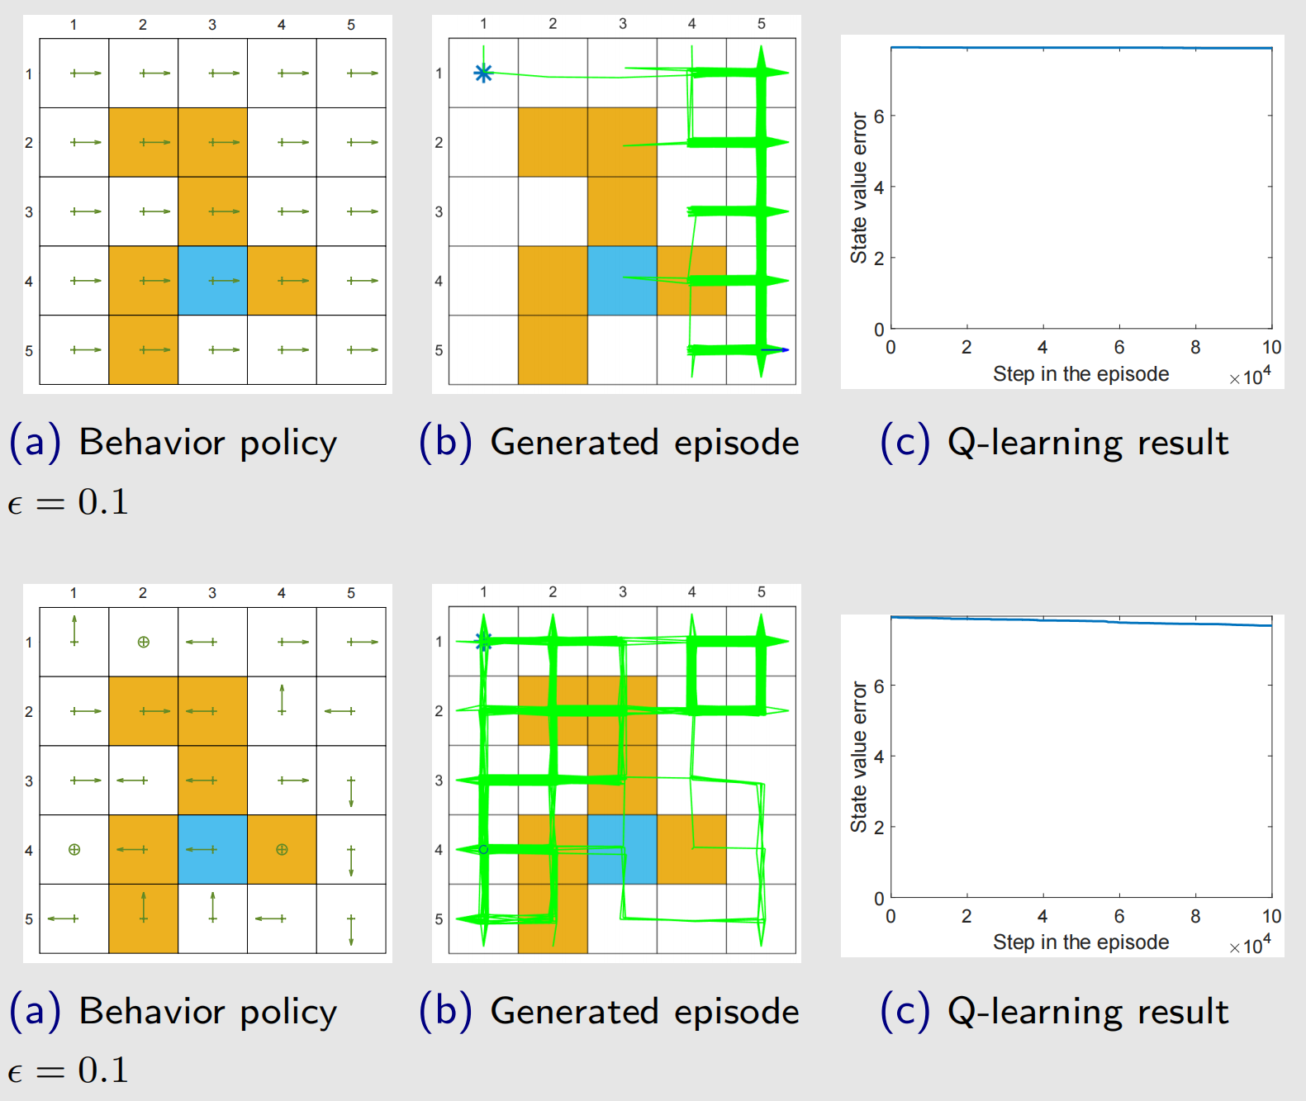
Q-Learning - Examples

Slide 54
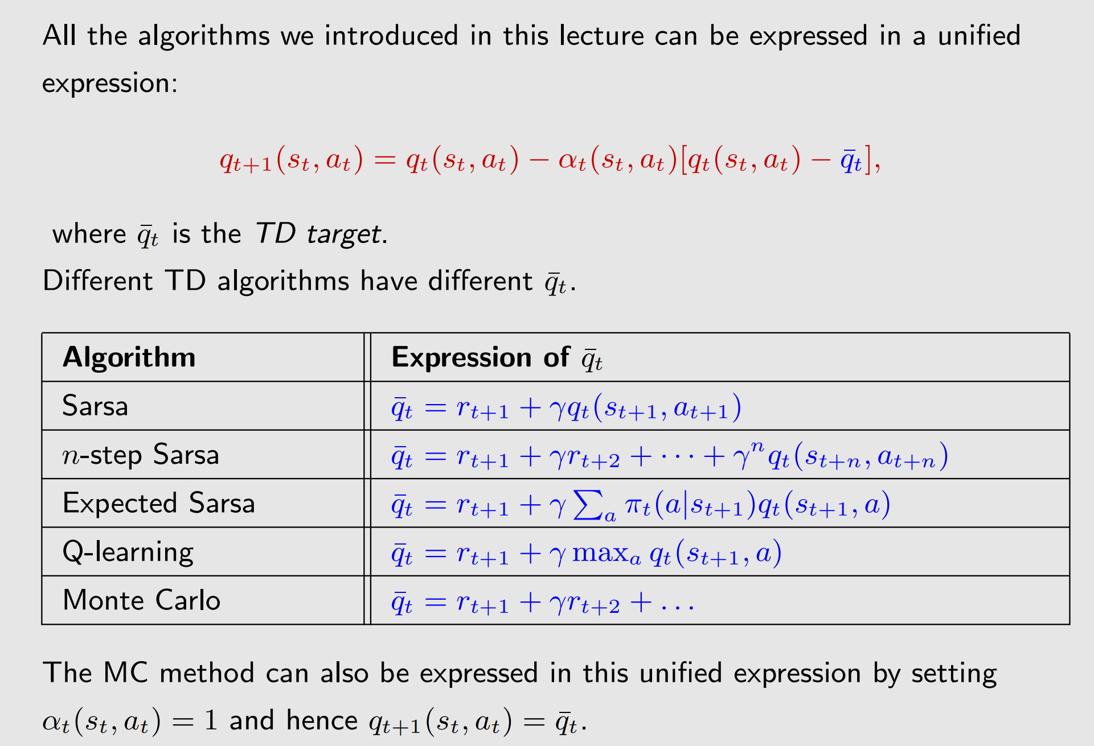
A unified point of view

Slide 55
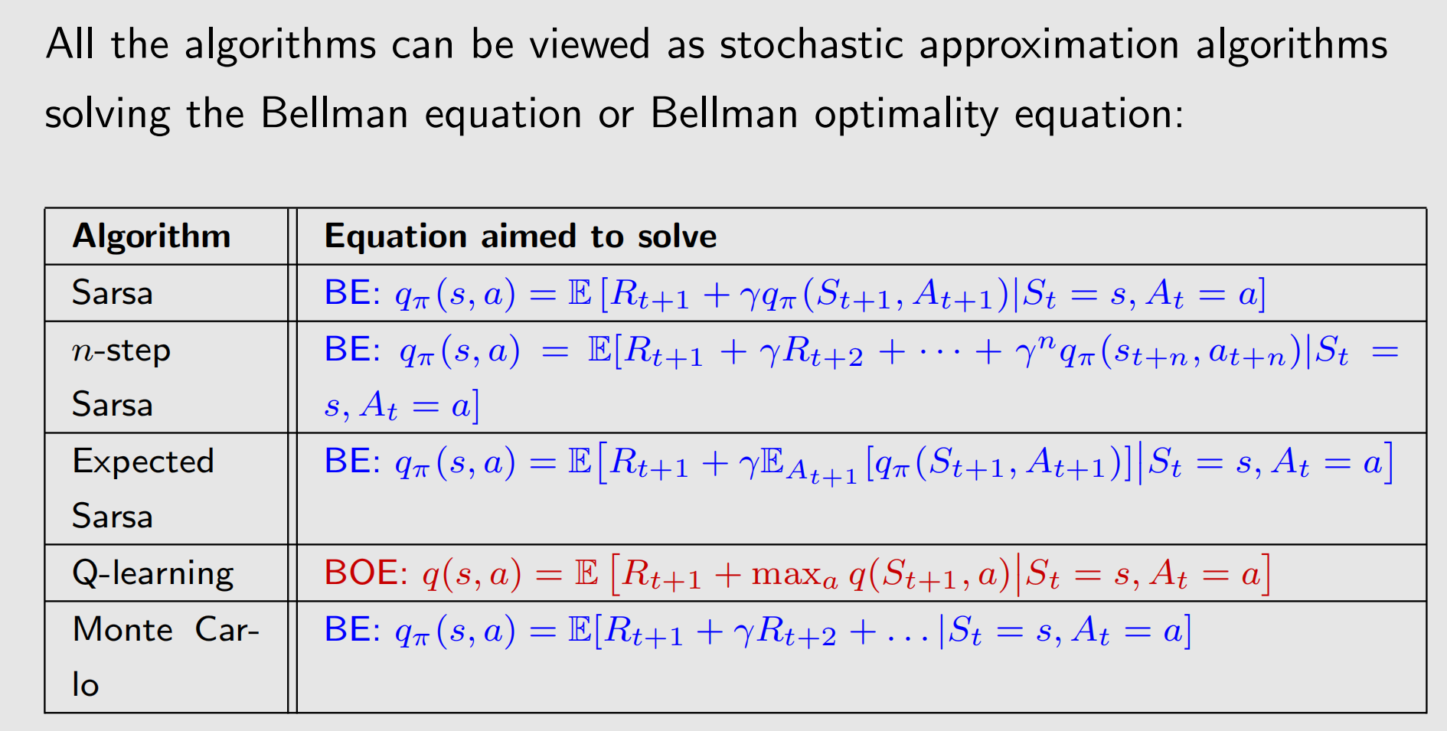
A unified point of view

Slide 56
Summary
Introduced various TD learning algorithms
Their expressions, math interpretations, implementation, relationship, examples
Unified point of view

